Slide 1
EPIC Aerosol Products
PI: Omar Torres, 614
Co-I’s: Robert C. Levy (613), Lorraine Remer (UMBC), Hiren Jethva (USRA), Jun Wang (UNL)
DSCOVR Science Team Meeting
NASA-GSFC
October 3-4, 2017
Algorithm Development Support: Changwoo Ahn (SSAI), Peter Leonard (ADNET)

Slide 2
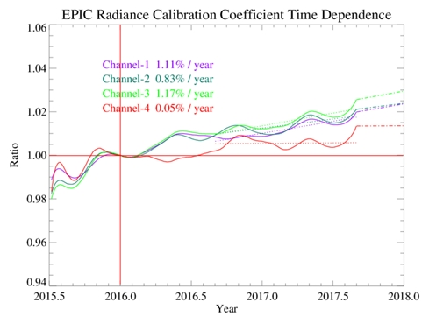
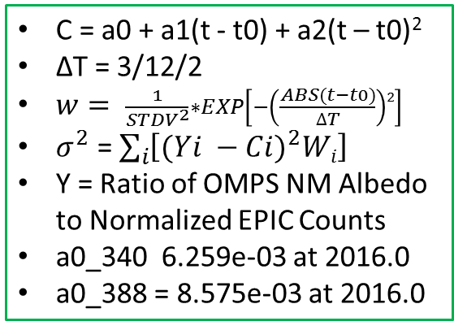
Time-Dependent Calibration Coefficients Using a Piecewise Parabolic Fit
C = a0 + a1(t - t0) + a2(t – t0)²
ΔT = 3/12/2
$w= \frac{1}{{STDV}^{2}}∗EXP\left[−\left(\frac{ABS(t−t0)}{∆T}\right)2\right]$
$σ^{2}$ = $\sum_{i}{\left[{(Yi −Ci)}^{2}Wi\right]}$
Y = Ratio of OMPS NM Albedo to Normalized EPIC Counts
a0_340 6.259e-03 at 2016.0
a0_388 = 8.575e-03 at 2016.0
(340 nm)
(388 nm)

Slide 3
Currently Available EPIC Aerosol Products and Status
Parameter | Status
UV Aerosol Index (UVAI) Aerosol Optical Depth (388 nm) Single Scattering Albedo (388 nm) Above Cloud Aerosol Optical Depth (388 nm) O2-AB Aerosol Layer Height | Ready for public release Validation in progress Evaluation in progress Under validation Optimization

Slide 4
The UV Aerosol Index
-Most widely known qualitative UV aerosol product
-Sensitive to aerosol absorption (carbonaceous, desert dust, volcanic ash aerosols)
-Detects absorbing aerosols over both lad and ocean surfaces
-Detects aerosols over ice/snow covered surfaces
-Detects aerosols mixed with and above clouds

Slide 5
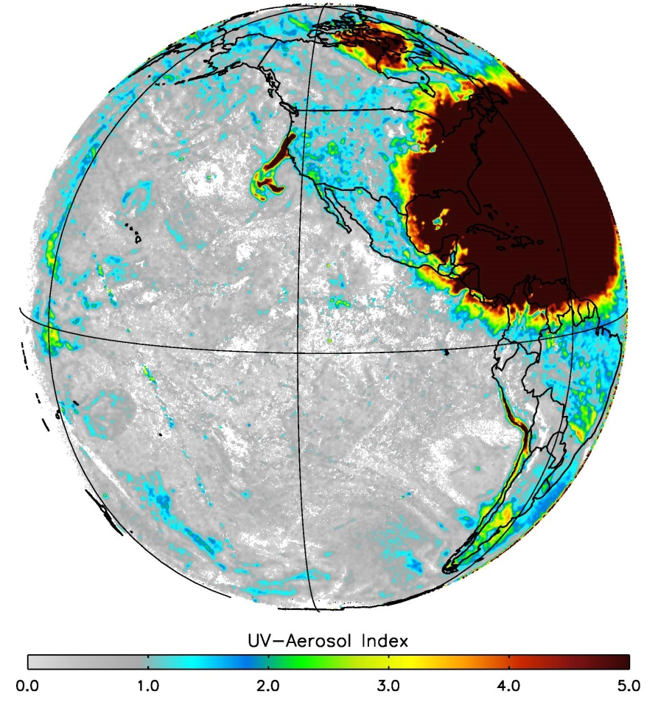
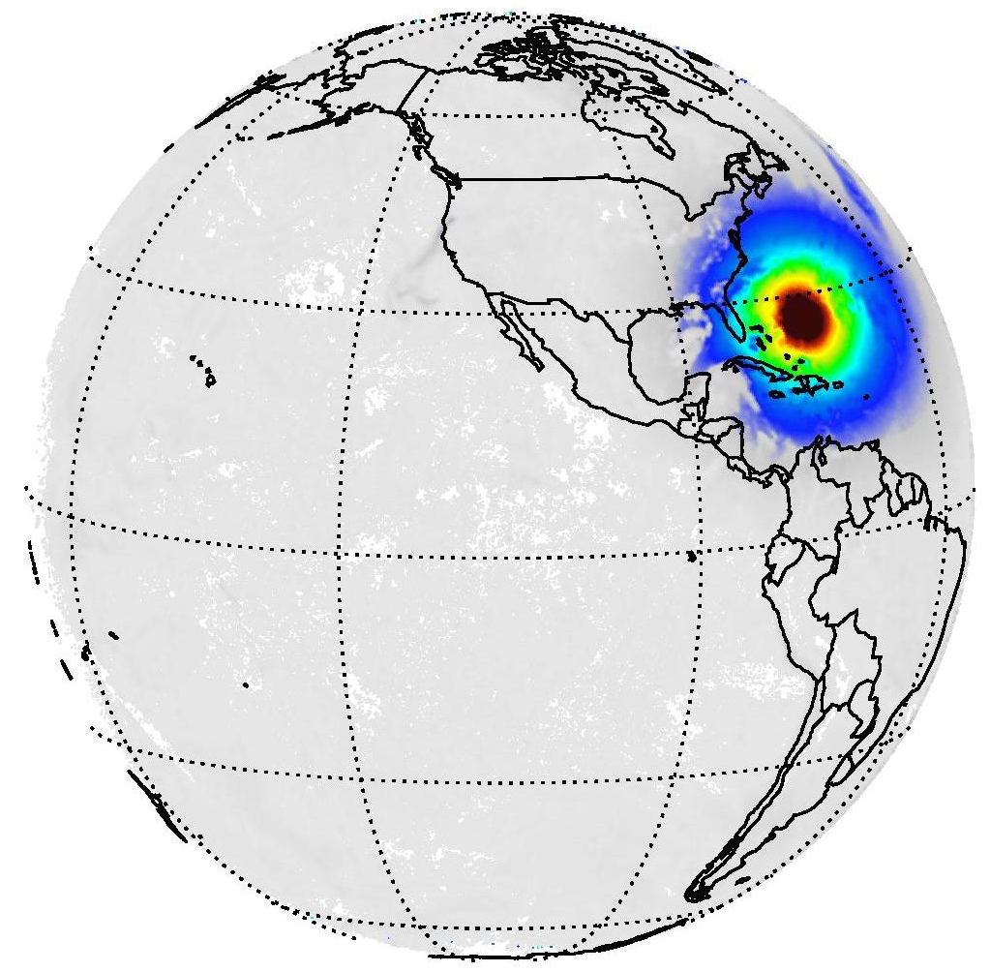

Solar Eclipse on Aug 21, 2017 (19:14:50 GMT)
in terms of EPIC’s Aerosol Index
Maximum AI of 418.074 at (Lat = 26.3867° N, Lon = 69.1873° W)

Slide 6
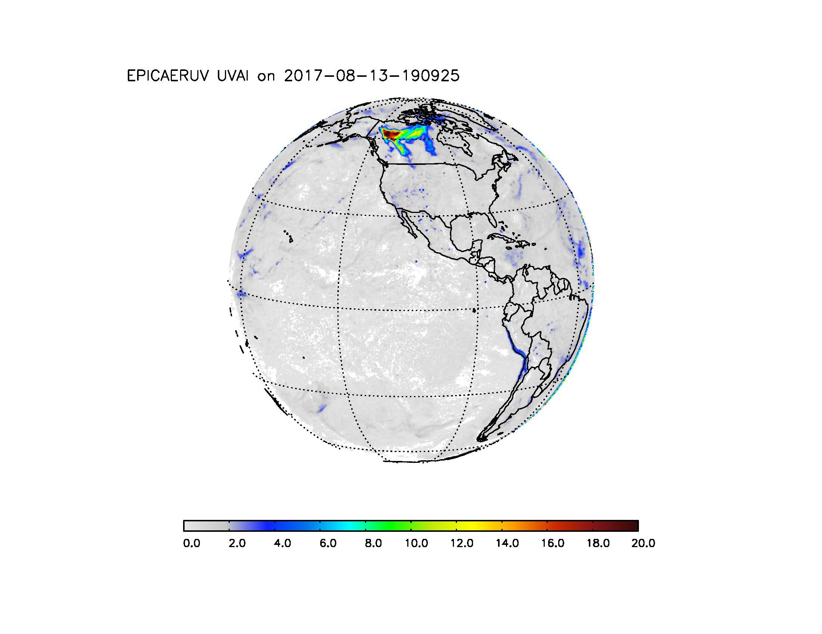
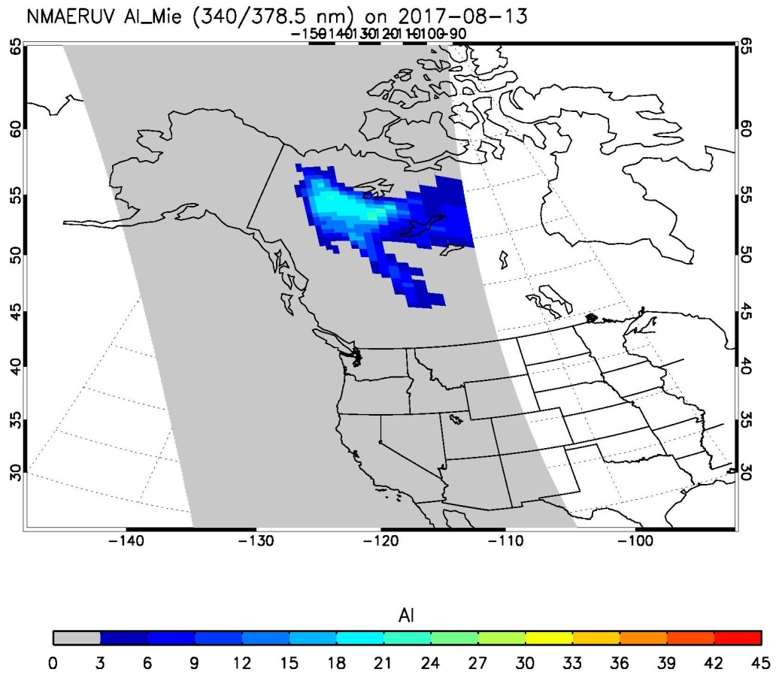
Record High Aerosol Index for an Actual Aerosol Event
August 13, 2017
19.1
22.4
EPIC Aerosol Index
NPP-OMPS Aerosol Index

Slide 7
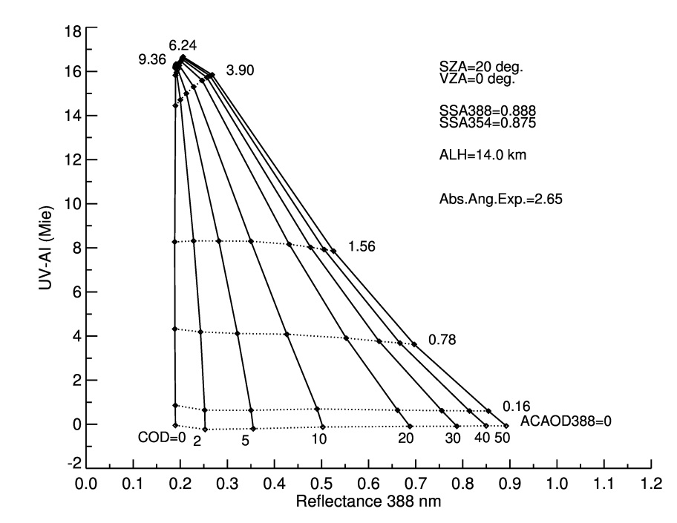
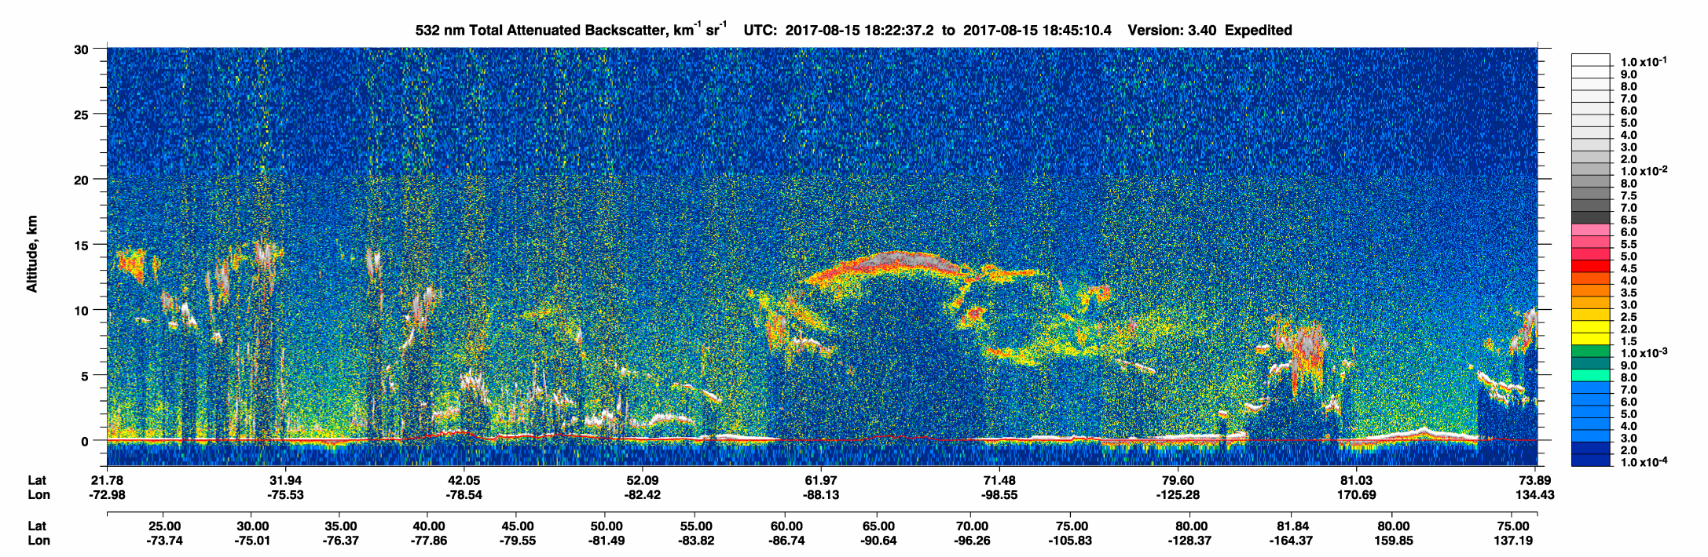
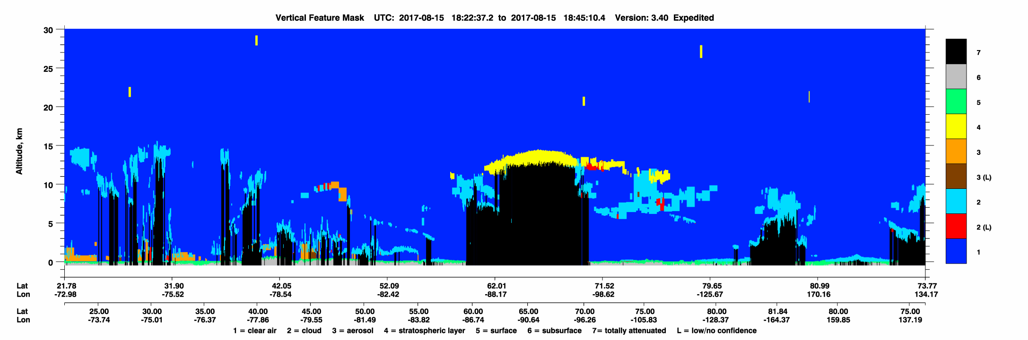
Modelling Results and Lidar observation of smoke injection height
Simulated Aerosol Index
-The unusually large AI value is the result of the aerosol layer height
-An stratospheric aerosol layer was detected by CALIOP and the OMPS Limb Profiler

Slide 8
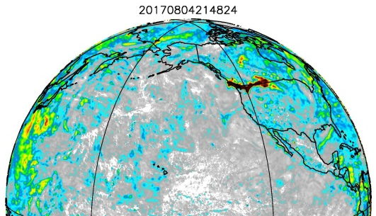
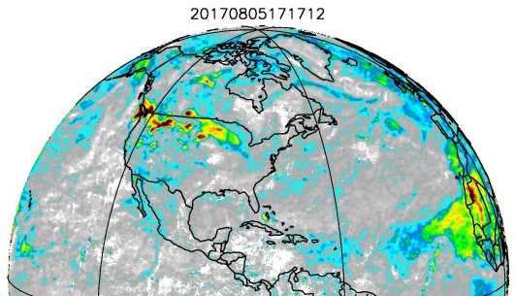
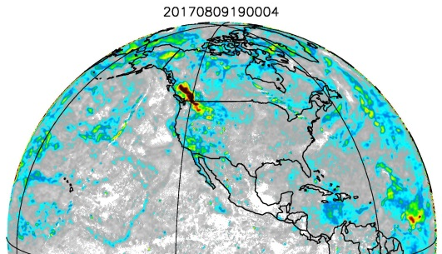
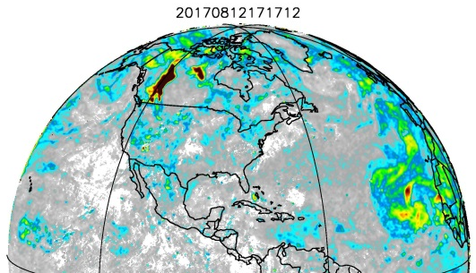
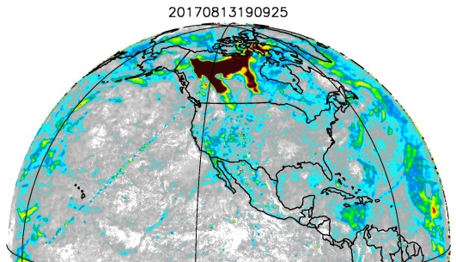
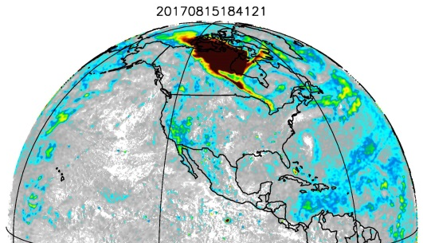
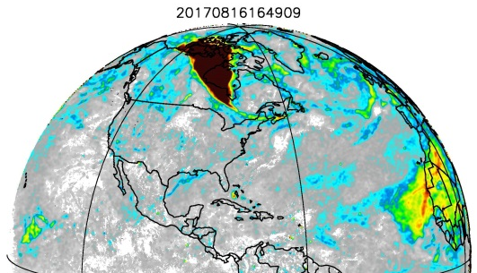
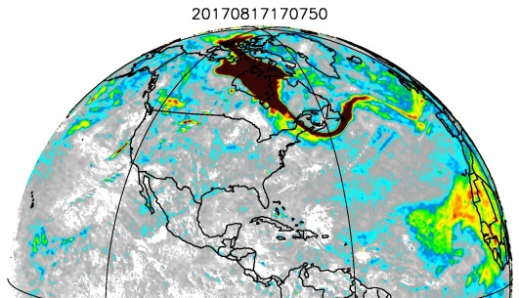
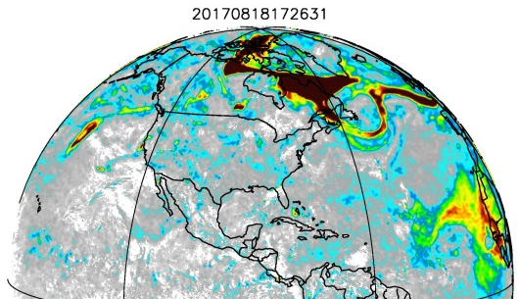
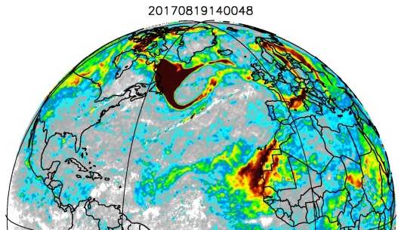
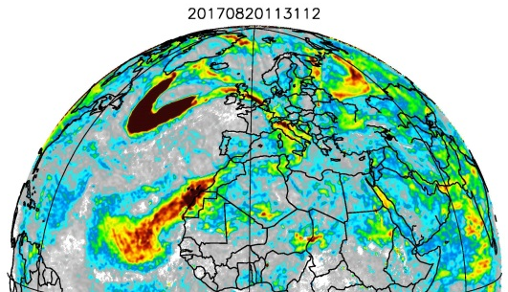
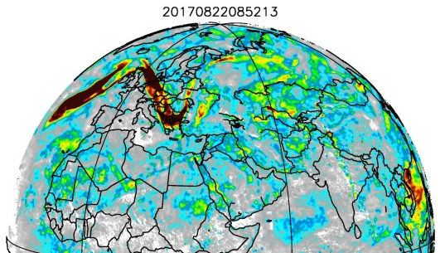
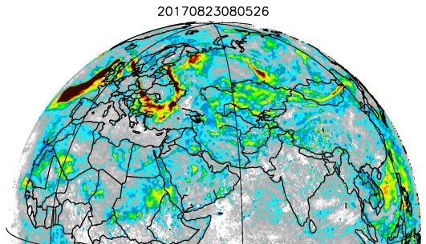
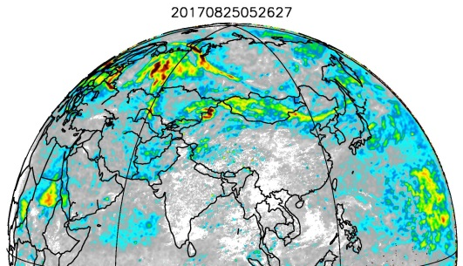
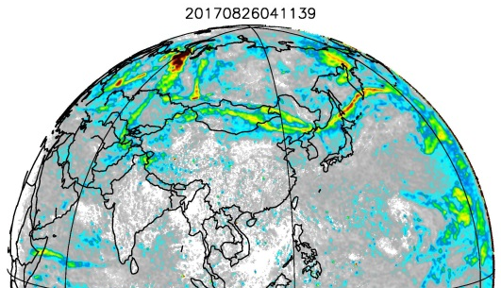
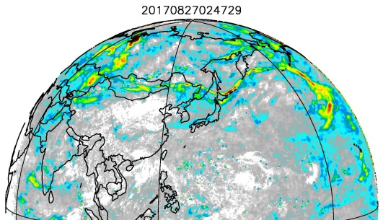
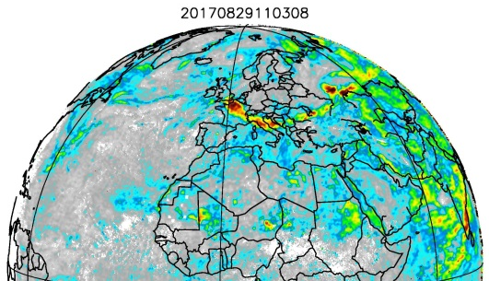
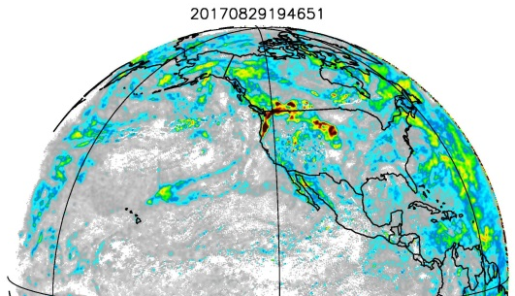
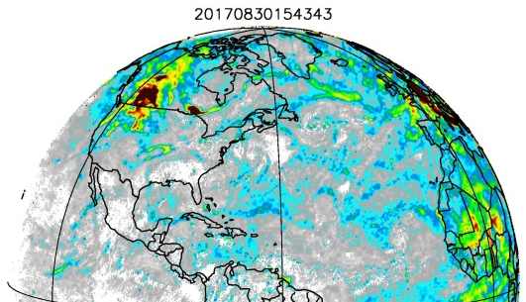
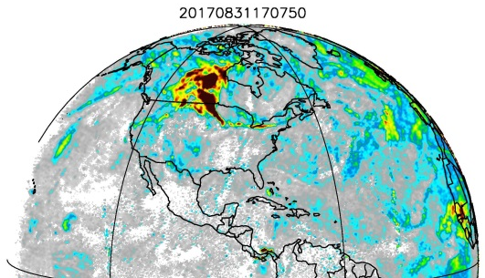
Unprecedented 45-day Pyro-cb Event

Slide 9
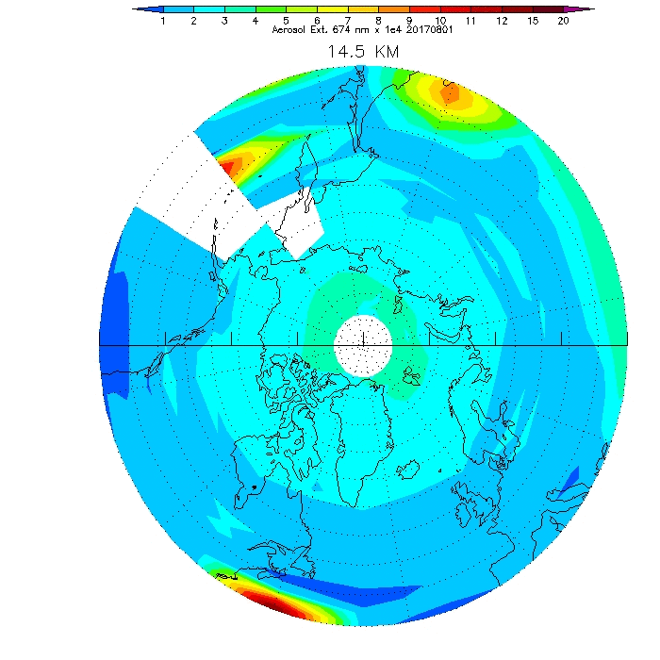
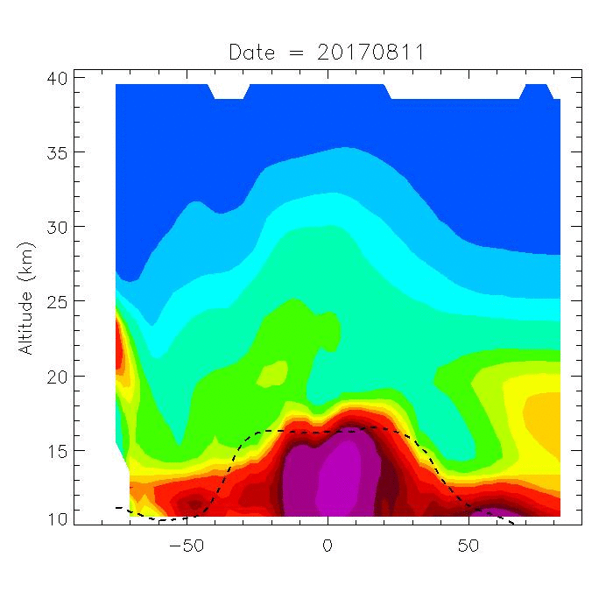
OMPS-LP View of B.C. Pyro-Cb
Courtesy of P.K. Bhartia and G. Taha

Slide 10
EPIC near UV Aerosol Algorithm
Level2 calibrated radiances at 340 and 388 nm
Surface Albedo
(OMI Climatology)
Radiative Transfer Calculations
Absorbing Aerosol Index
-AIRS CO data:
Three aerosol types:
Desert Dust
Carbonaceous aerosols
Weakly absorbing
Seven aerosol models per type
(varying ω₀)
-Surface Type
Aerosol Type
Cloud Screening
Aerosol Layer Height
CALIOP Climatology
GOCART Climatology
Assumed aerosol parameters:
-Particle size distribution
-Real comp. refractive index
-Relative spectral dep. of imag. refractive index.
Inversion Scheme
Extinction optical depth
Single Scattering Albedo
Lookup Tables

Slide 11
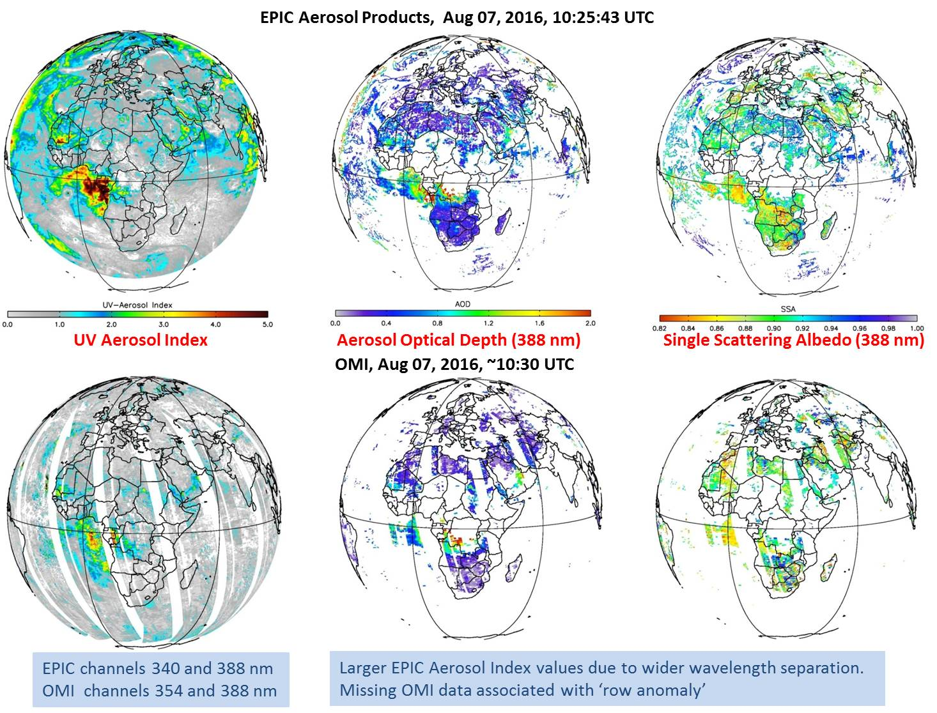

Slide 12
EPIC 388 nm AOD validation using AERONET observations
at sites around the world

Slide 13
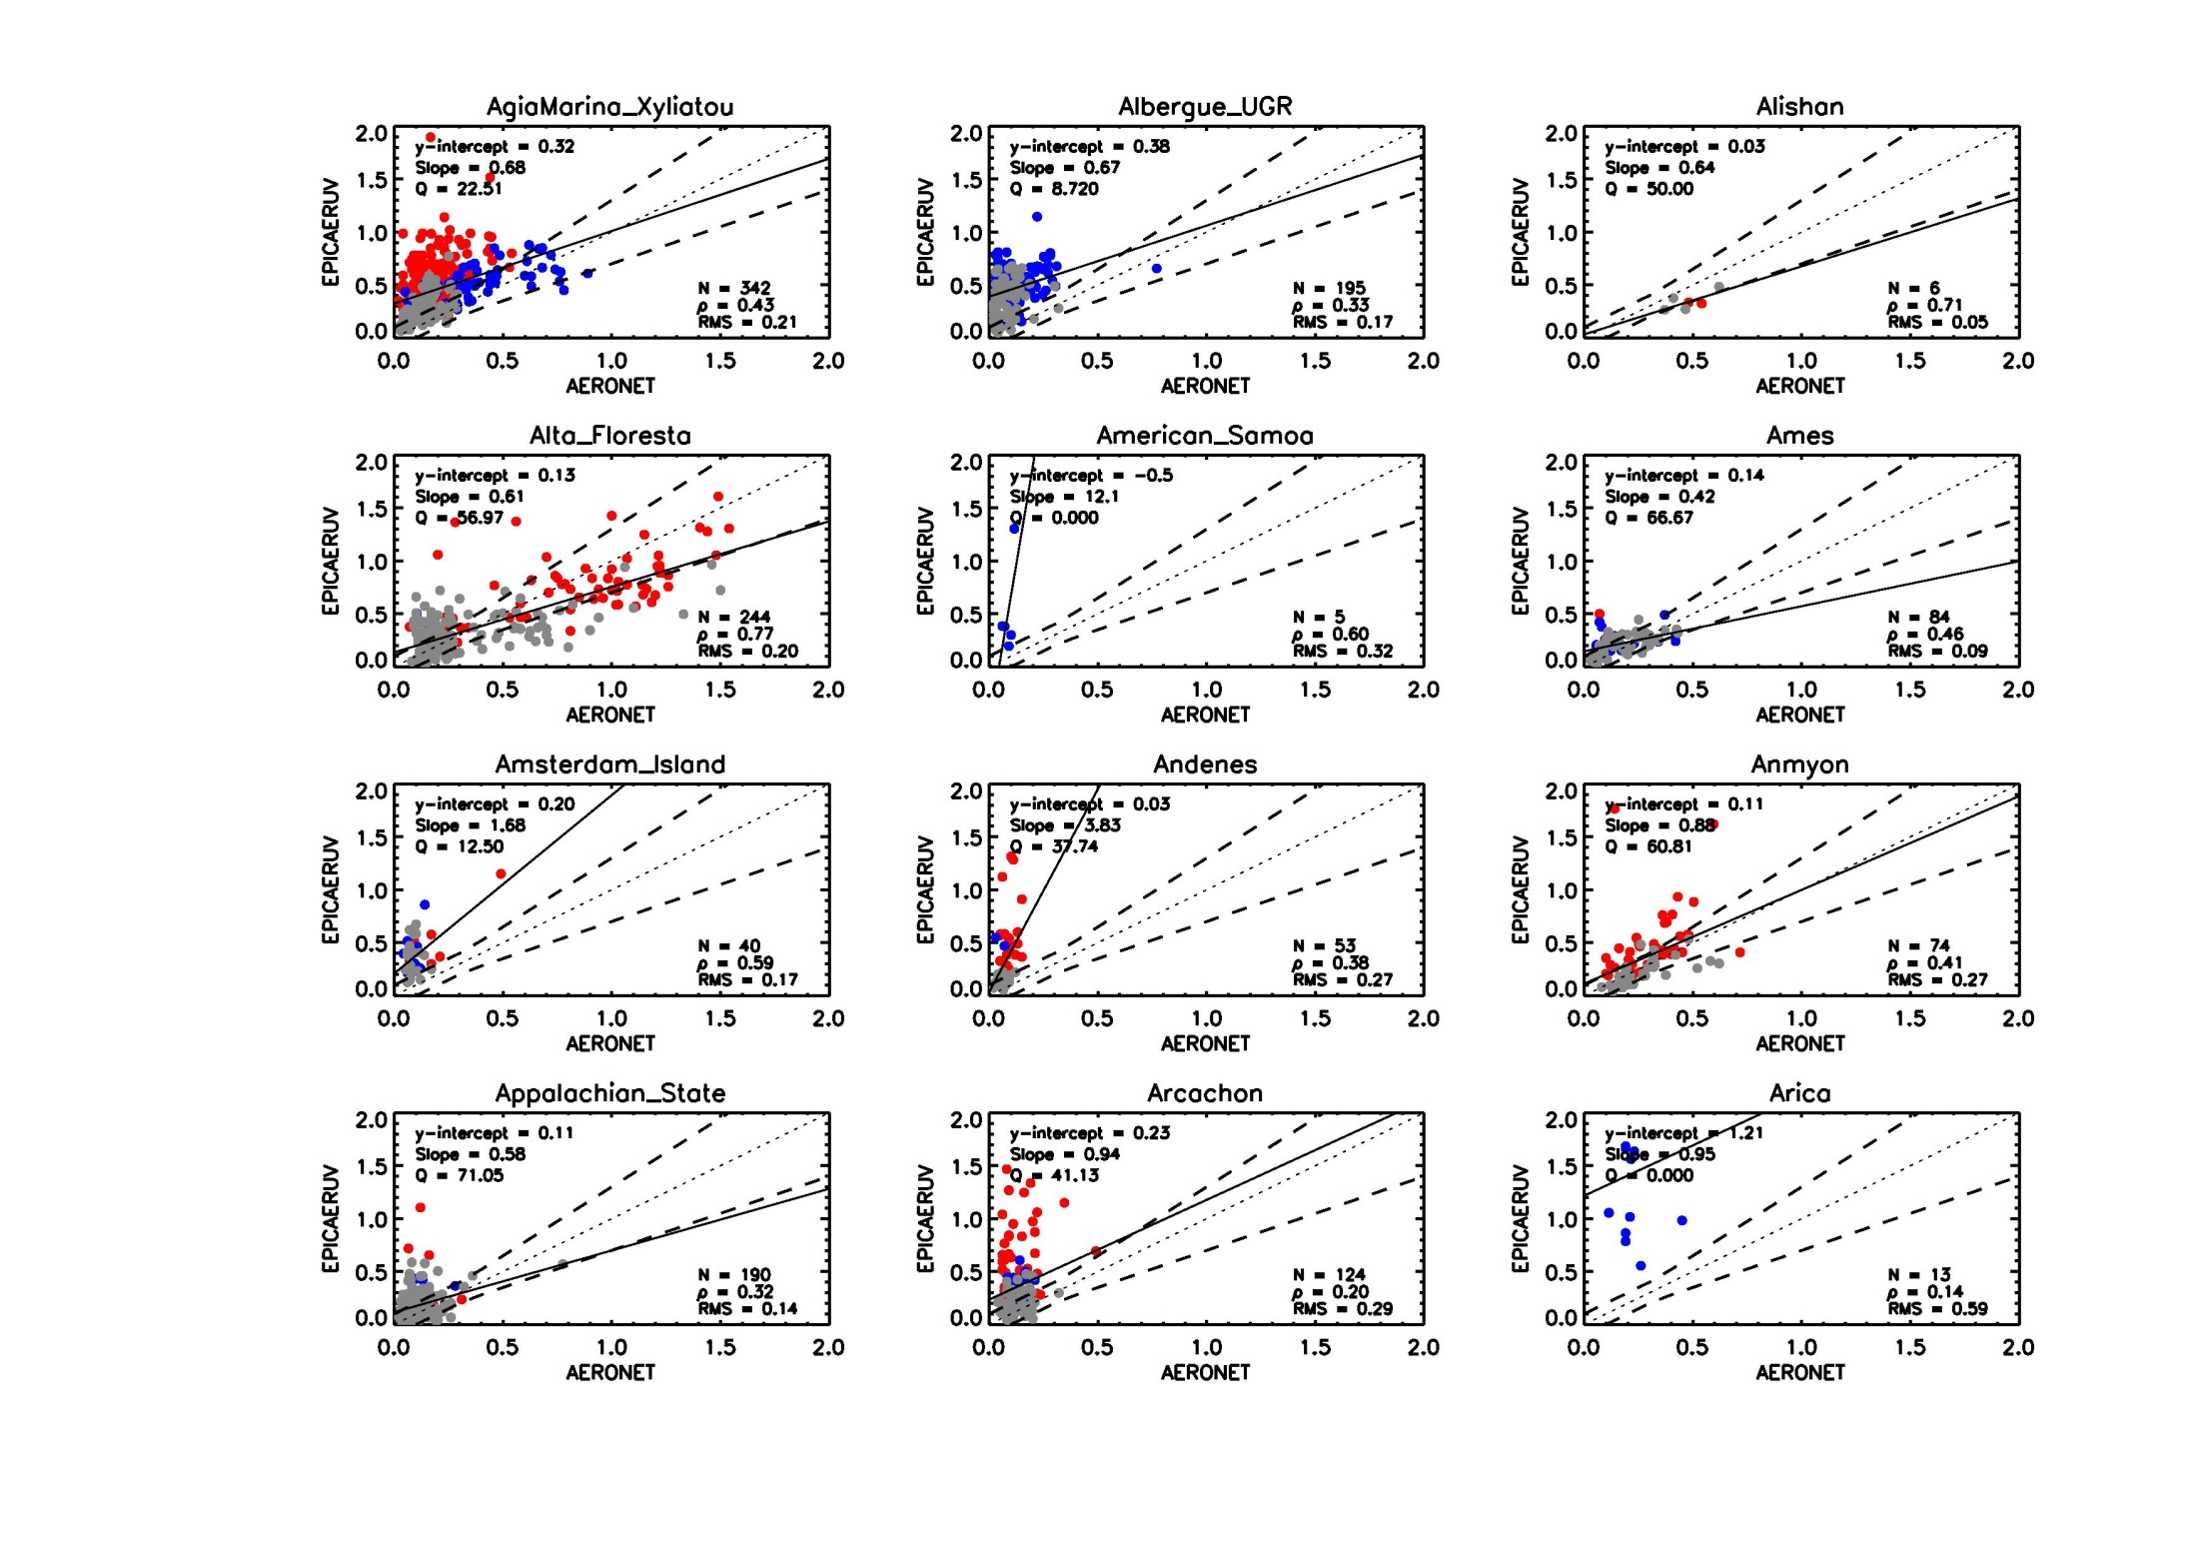
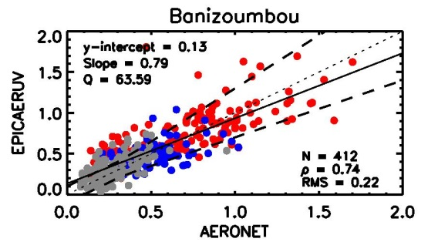
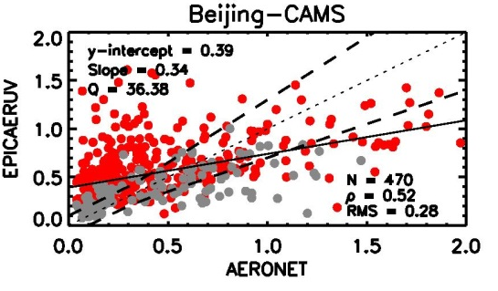
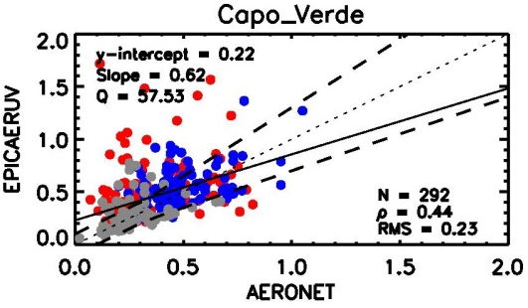
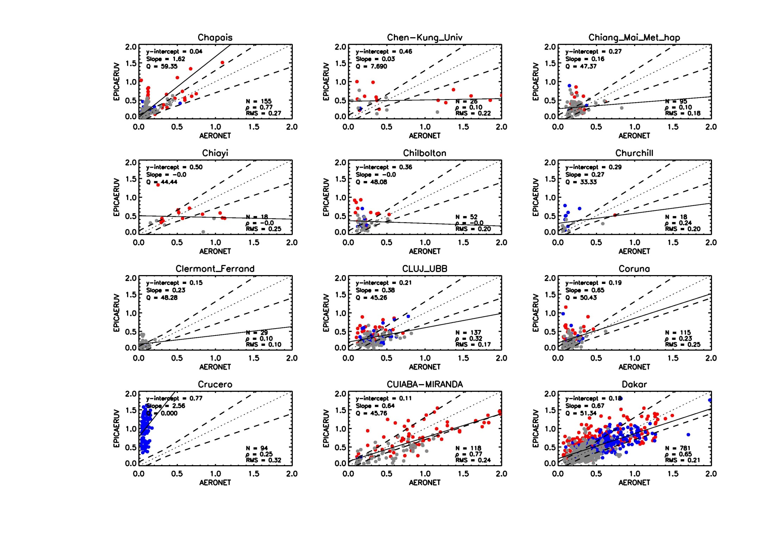
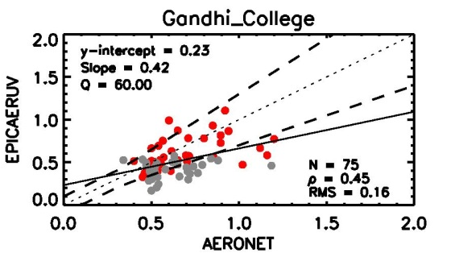
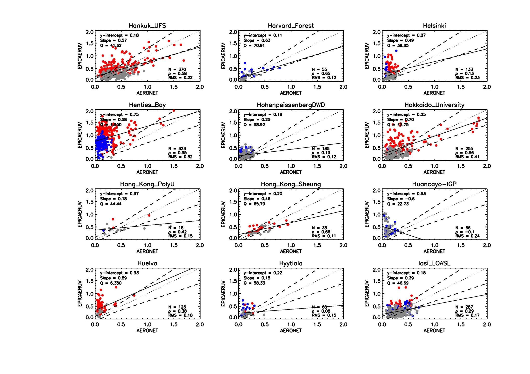
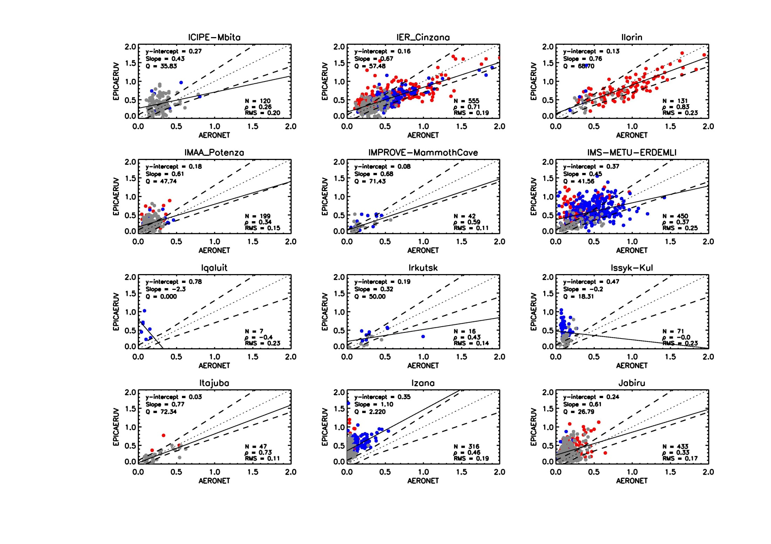
  (20 km radius and ± 10 minute window and SZA < 70°)

Slide 14
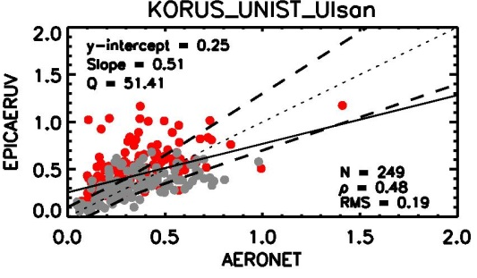
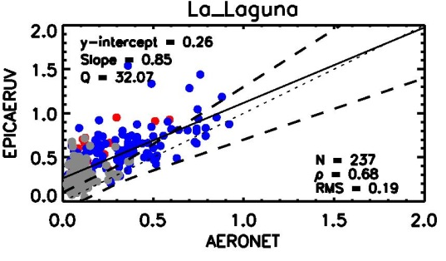
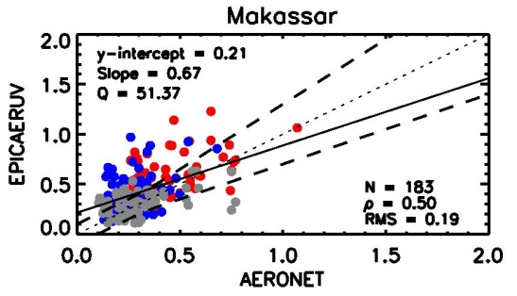
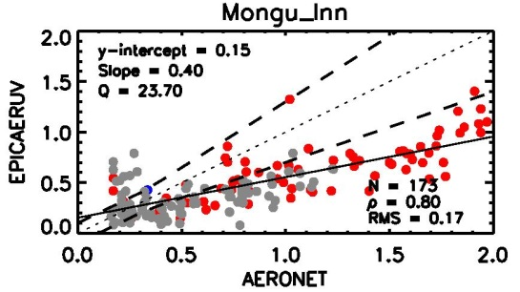
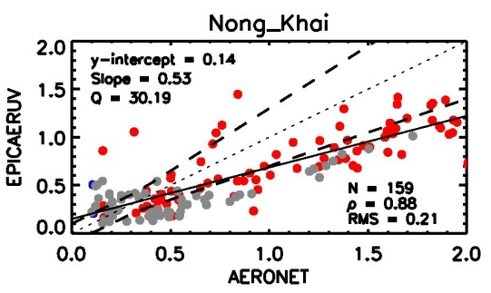
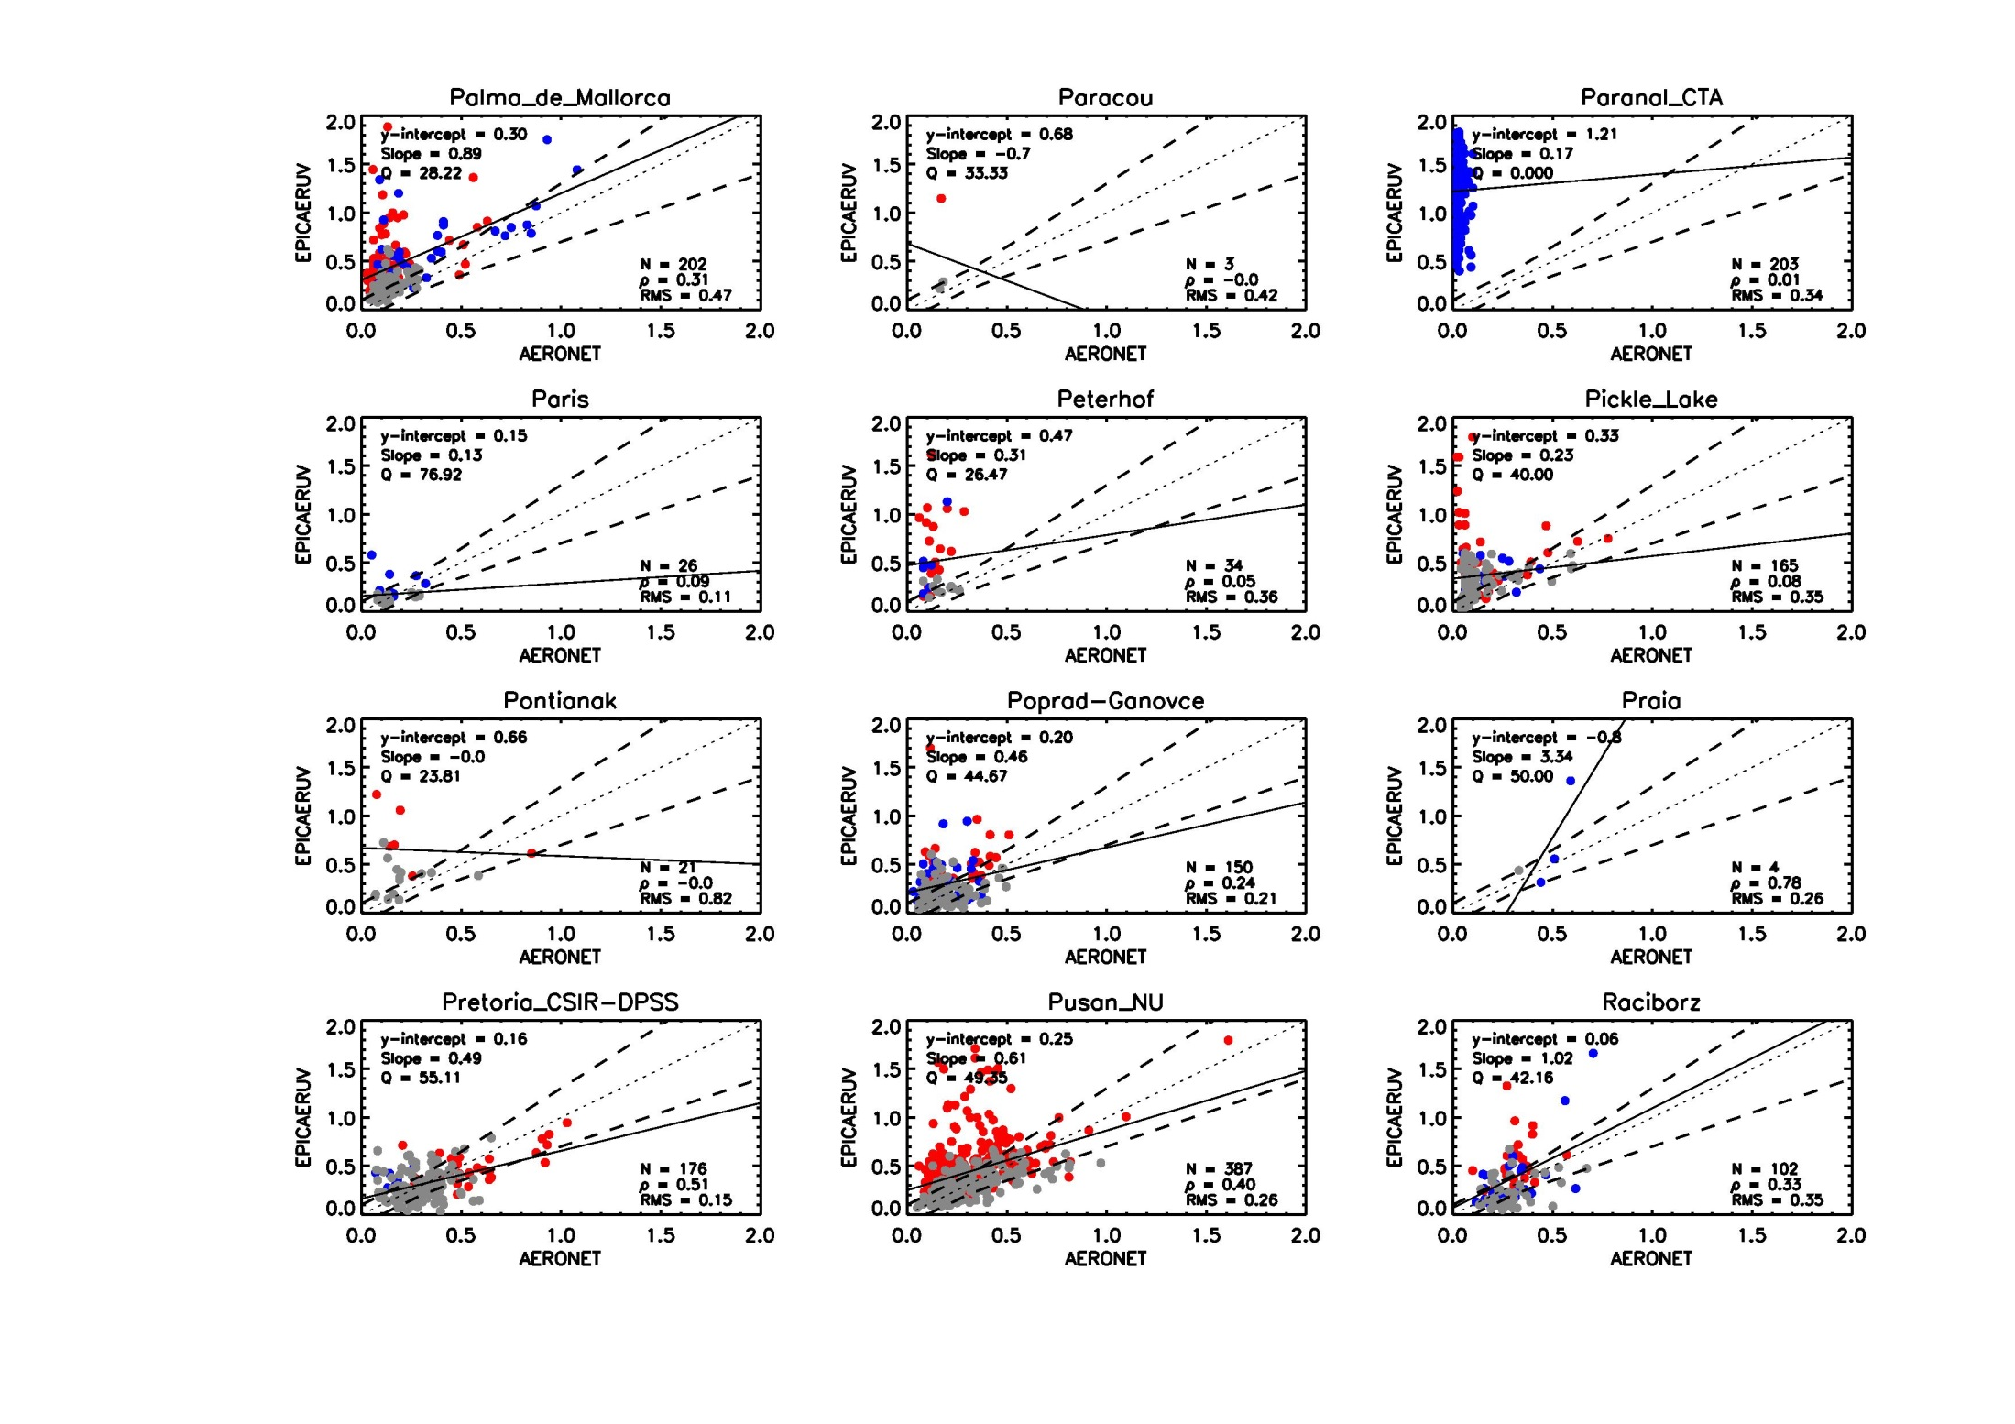
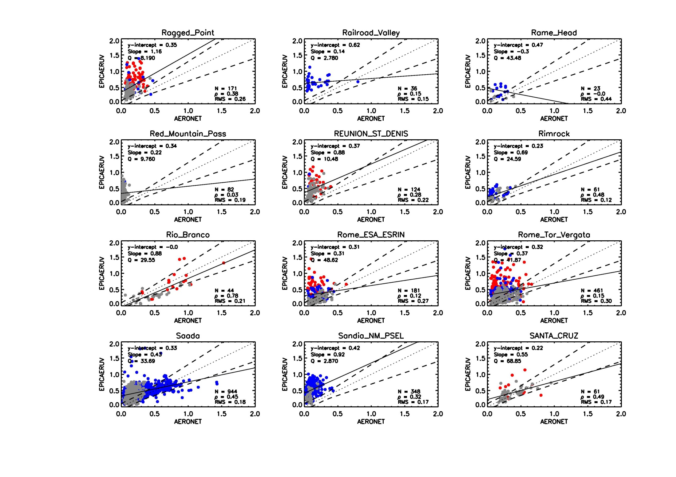
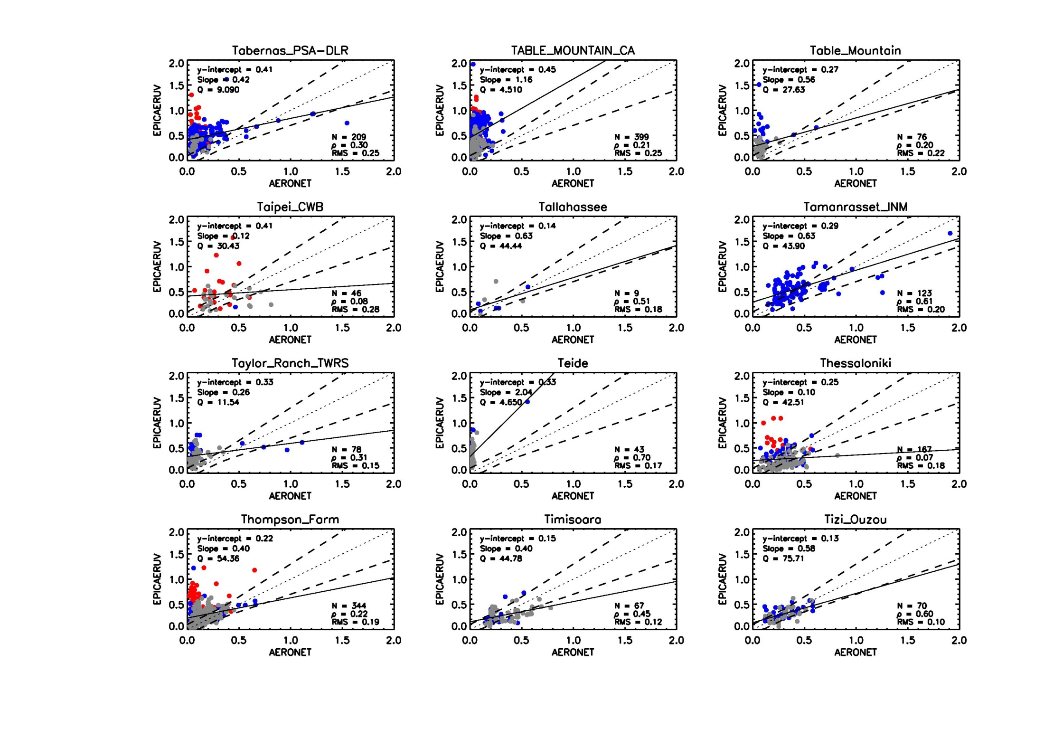
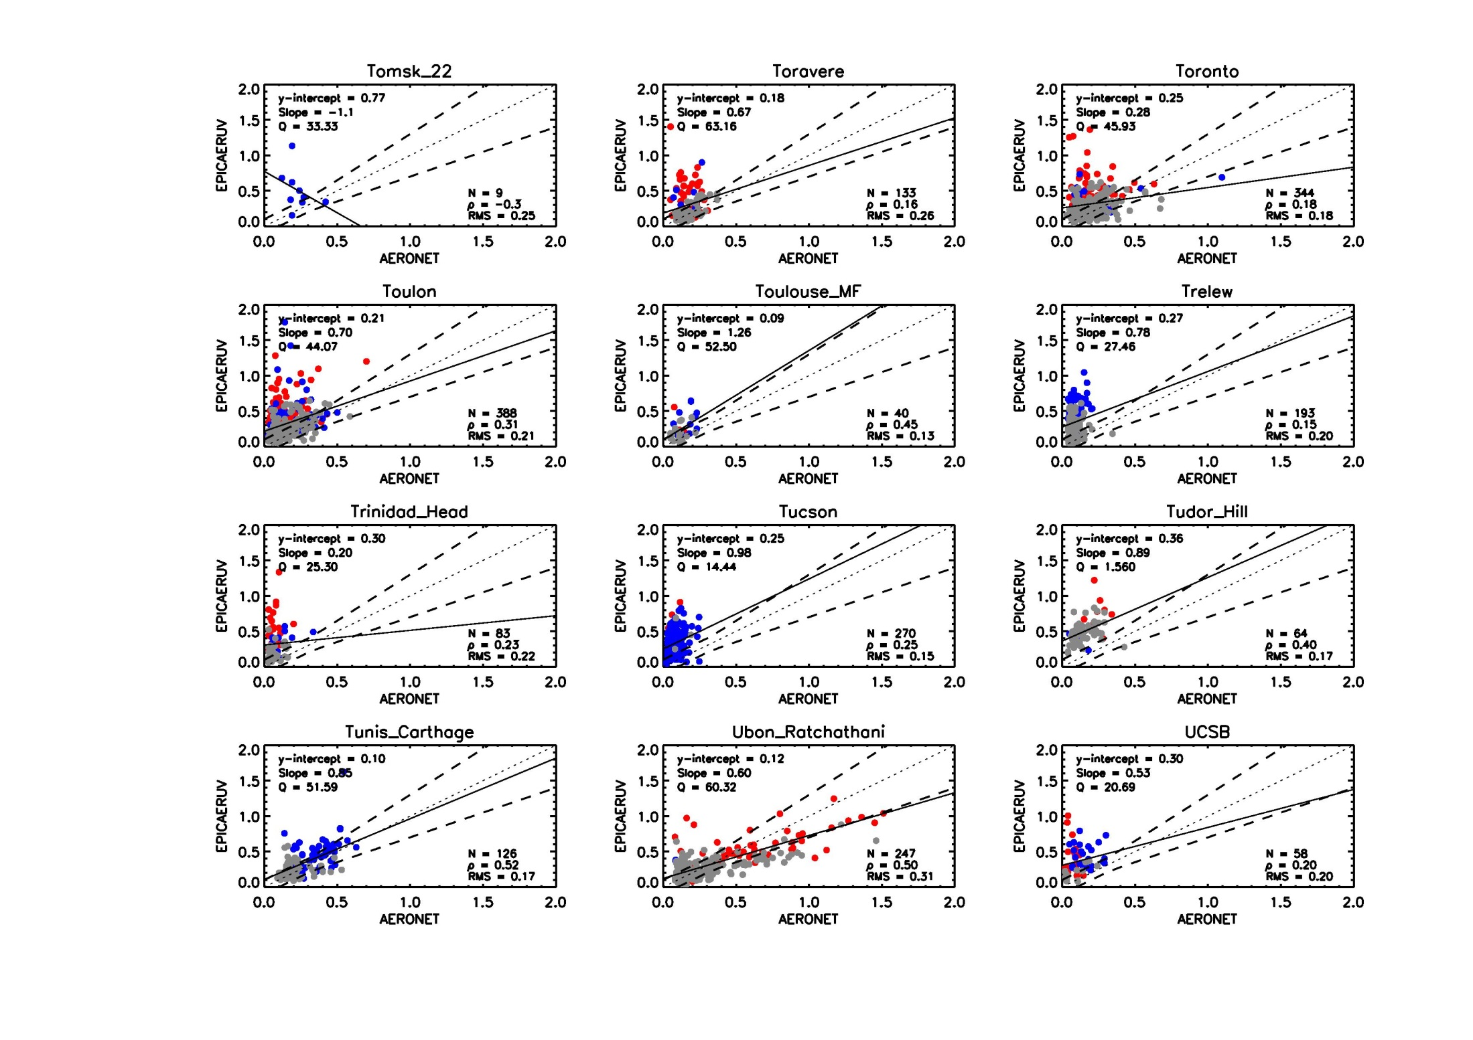
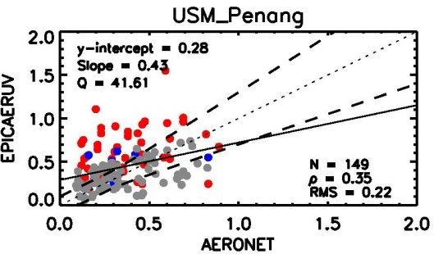



Slide 15
EPIC 388 nm SSA comparison to AERONET retrievals
at sites around the world

Slide 16














EPIC-AERONET Comparison at selected sites

Slide 17




EPIC-AERONET Comparison by aerosol-type at 380 sites

Slide 18




Slide 19
EPICAERAC-The above-cloud aerosol algorithm for EPIC
EPICAERAC is built upon the combination of EPICAERUV (UV Aerosol Index algorithm for EPIC) and OMACA (OMI above-cloud aerosol package)
Retrieves above-cloud aerosol optical depth and aerosol-corrected cloud optical depth simultaneously
Algorithm is similar to OMI above-cloud aerosol package but adjusted to the EPIC wavelengths (340,388 nm)
Both carbonaceous and desert dust aerosols are considered

Slide 20




Slide 21



Slide 22


Retrieving aerosol layer height from EPIC O₂ A and B bands
Jun Wang
Xiaoguang Xu
University of Iowa
A case study: EPIC at 2016-04-17 14:59 UTC
RGB
AOD
H, km
CALIPSO
track
sun glint
removed
CALIPSO 2016-04-17 14:18 UTC
EPIC retrieved H
clouds
EPIC retrieved H
Notes:
Retrieval results of AOD and aerosol height from EPIC O2-A and B bands
Validate with collocated CALIPSO measurements of backscatter and extinction coefficients.

Slide 23












Potential Improvement of AOD/SSA retrievals using O2AB ALH
CALIOP Aerosol Height Climatology
O2-AB Aerosol Height
AOD_CALIOP
AOD_O2AB
SSA_CALIOP
SSA_O2AB
EPIC 2016-04-18-144210

Slide 24
Summary
Entire record of UVAI, and AOD & SSA has been transferred to ASDC.
Preliminary evaluation results of AOD & SSA products using AERONET observations has been carried out.
Validation of ACAOD product has started.
Ongoing and future work
- Preparation of README files and ATBD’s
- Combine clear sky AOD/SSA and ACAOD/COD retrieval schemes into a single algorithm.
- Optimize application of O2AB aerosol layer height to smoke layers and in-land and in-land applications

Slide 25









