Slide 1
Constructing a long-term record of cloudiness from SBUV radiances using EPIC
Clark J Weaver Earth System Science Interdisciplinary Center
Dong Wu Climate and Radiation Branch GSFC
P. K. Bhartia Atmospheric Chemistry and Dynamics Branch GSFC
Gordon Labow SSAI
David Haffner SSAI

Slide 2
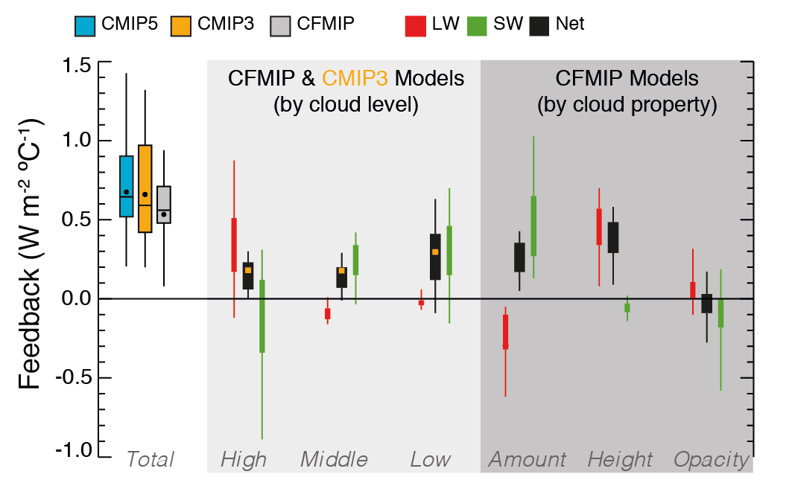
Cloud Feedback Model Intercomparison Project (CFMIP)
SW
Clouds accelerate
warming by GHG
Clouds moderate
warming by GHG
IPCC AR5 Chapter 7 Summary …
… despite modest improvements there remain significant errors in the model simulation of clouds. There is very high confidence that these errors contribute significantly to the uncertainties in estimates of cloud and hence the spread in climate change projections reported.
Notes:
We hope to reduce the error bar in the SW cloud feedback. This value ranges from almost zero to 1 Watt m2 per degree C of global warming.
Longterm consistent cloud data records are important for understanding cloud climate feedbacks. UV provides a unique coverage and sensitivity to clouds that are in the middle troposphere.

Slide 3
Currencies
Lambertian Equivalent Reflectance - LER
Cloud=0-90 RU
Reflectance of lambertian surface on earth surface consistent with observed
Radiances after rayleigh scattering of atmosphere has been removed
LAND
Reflectance = 2-4 RU
OCEAN
Reflectance = 5-8 RU
Cloud Optial Depth - COD
Retrieved COD from observed intensities
Using precalculated Look-up-tables VLIDORT 2.7
Assume C-1 water cloud
Cox-Munk sea-water BRDF
New GISS Version 2.7a
Climatological Chlorophyll
GMAO wind-speeds.
Notes:
Currencies used in this study are LER and COD

Slide 4
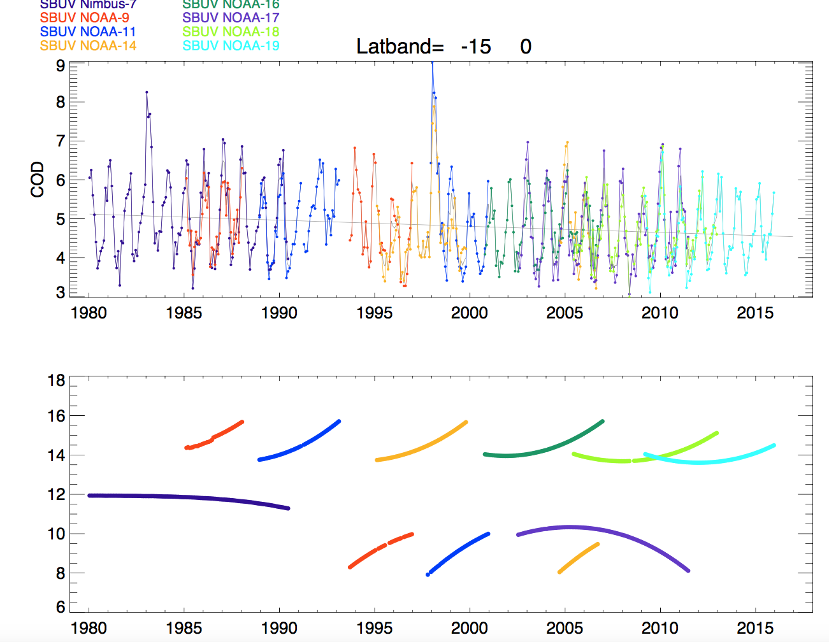
Noon adjusted COD
Local Time
Hours
Notes:
Some latitude bands look great.
One indication that our COD calculation is in error is that (go back to slide 10) many of the diurnal cycles away from the statocu areas are peaked and symetric around noon time.
Suspect that our C-1 water cloud model or the Cox Munk is not adequate
So ..

Slide 5
Antarctic Calibrated SBUV Intensities
(from N-values
331 & 340nm )
Lambertian Equivalent Reflectivity
Notes:
Initial studies done by Jay Herman used LER as currency – but difficult to compare with climate models,
Does not adequately represent cloud-free scenes over Ocean.
Does not adequately acount for cloud BRDF

Slide 6
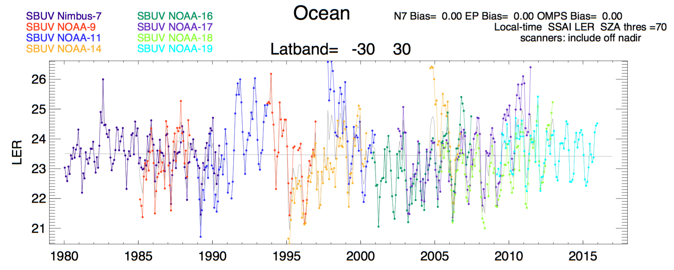
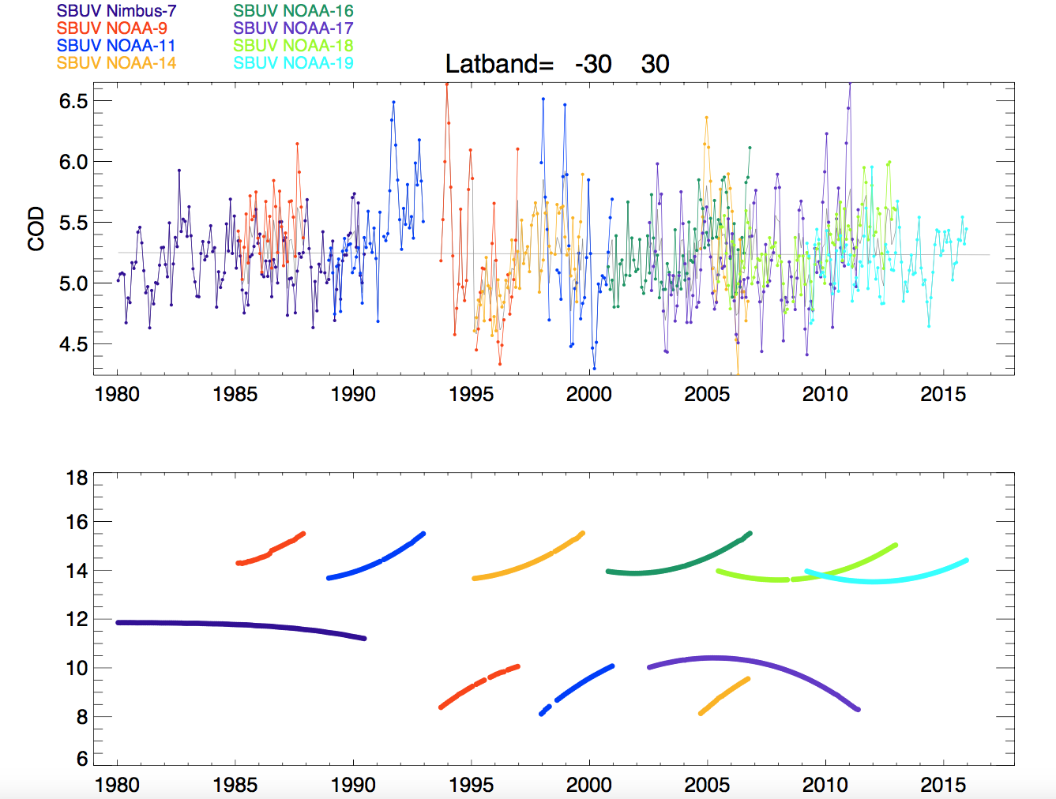
LER
Local Time
Hours
LER dependent on Local Time
Low midday values and higher ones in morning or afternoon
Notes:
LER for individual SBUV instruments starting in 1980 with Nimbus-7 and ending with NOAA-19.
Appears that there is a dependence between LER and Local Time:

Slide 7
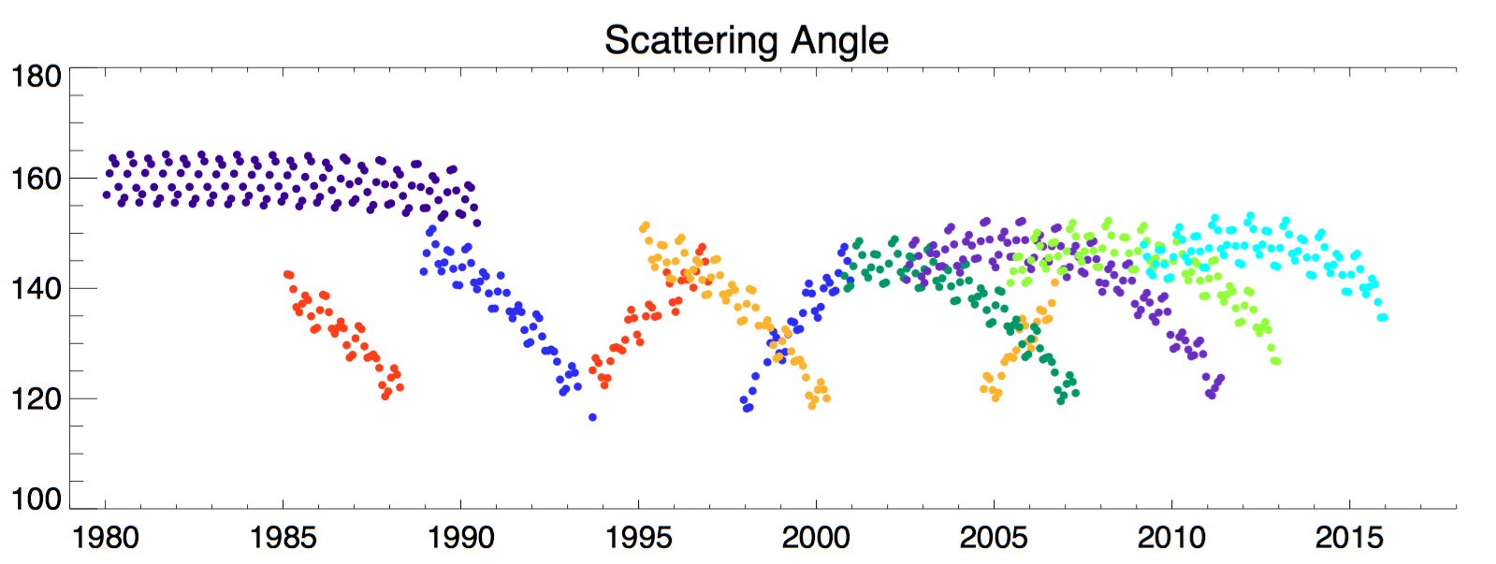
LER
Scattering Angle
Degrees
OR …
LER dependent on Scattering Angle (180º = Backscatter)
Notes:
Or it could be a dependence between LER and satellite scan angle
Strong scattering (almost backscattering) associated with lower LER and lower scattering associated with higher LER

Slide 8
Antarctic Calibrated SBUV Intensities
(from N-values
331 & 340nm )
Lambertian Equivalent Reflectivity
Cloud Optical Depth
Adjustment to Noon-time
Cloud Optical Depth
SBUV
Diurnal cycle
Longterm Trend
Calibration Errors between SBUV instruments
Notes:
Our approach was to account for cloud BRDF by using using C-1 water cloud optical depth with Cox Munk ocean BRDF.
Account for cloud diurnal cycle by using combined statistics of all SBUV satellites.
Entanglement issues

Slide 9
Antarctic Calibrated SBUV Intensities
(from N-values
331 & 340nm )
Lambertian Equivalent Reflectivity
Cloud Optical Depth
Adjustment to Noon-time
Cloud Optical Depth
EPIC
Diurnal cycle
Notes:
Our approach was to account for cloud BRDF by using using C-1 water cloud optical depth with Cox Munk ocean BRDF.
Account for cloud diurnal cycle by using combined statistics of all SBUV satellites.
Entanglement issues

Slide 10
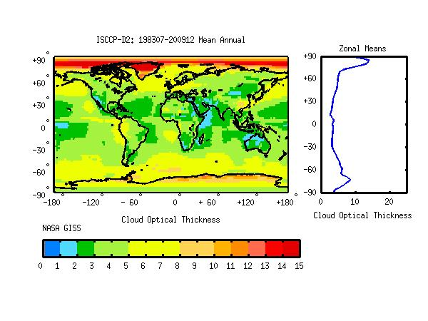
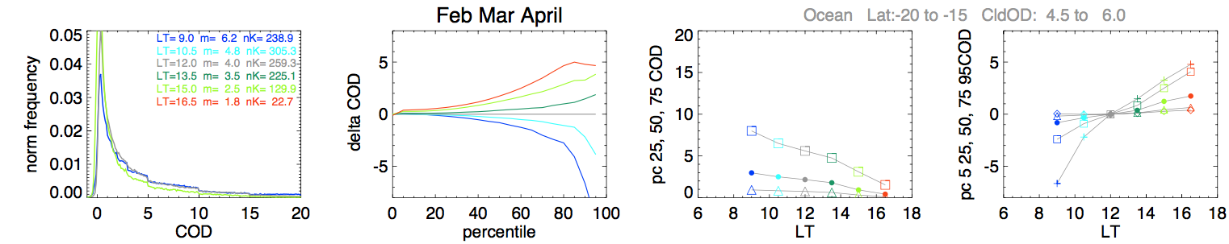
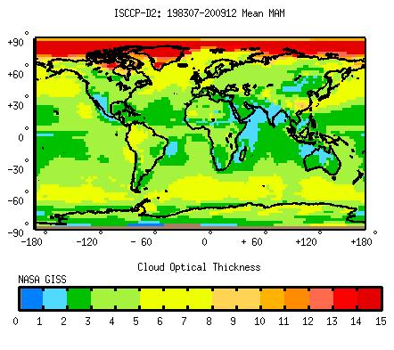
Ocean Lat: 20º to 15º S
Climatological COD 4.5-6.0
ISCCP Climatological COD Mean Annual
Feb March April
Number
Samples
Mean COD
Local time
AM
PM
ISCCP COD Mar April May
Frequency of low COD is highest in afternoon
Mean daily COD about 4, consistent with ISCCP
Notes:
We divide the earth into 5 degree latitude bands and then further divide them by climatological COD from ISCCP.
So here we consider only the COD from 4.5-6 i.e. yellow to light green areas where there are Stratocumulus clouds off the coast of SA and Africa.
It’s a crude attempt to separate the higher altitude towering cumulus from the low level stratocumuls clouds
Construct a frequency distribution of COD at different local times for area

Slide 11
Ocean Lat: 20º to 15º S
Climo COD 4.5-6.0
4:30pm
noon
Feb March April
9am
COD by Percentile
Adjustment to local noon
25th
Delta COD
75th
50th
75th
50th
25th
90th
Local Time
Local Time
For COD values at 50th percentile:
for 9am observation time, reduce COD by 1
for 4pm observation time, add 1.5 COD
Notes:
From each time of day we generate a cumulative distribution – this yields COD values for different percentile bins.
So at 9am …. But at 4:30
After Adjustment to local noon the frequency distribution should be close to the local noon observed frequency distribution

Slide 12
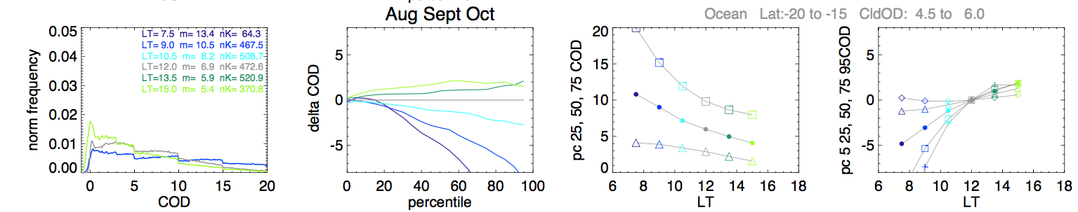
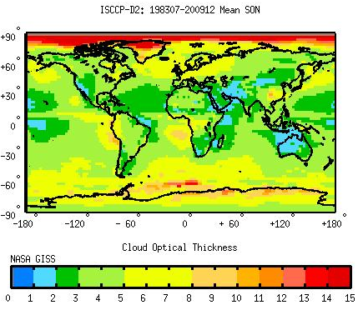
ISCCP COD Mar April May
75th
50th
25th
Thinner Clouds in March-May
ISCCP COD Sept Oct Nov
Thicker Clouds in Sept-Nov

Slide 13
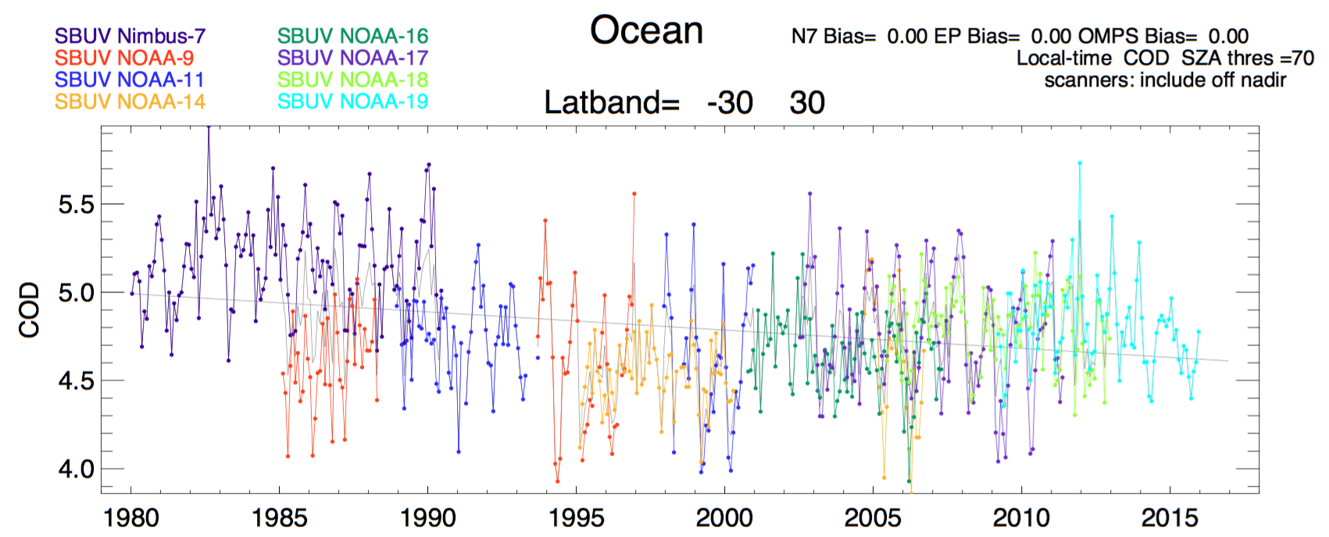
COD
Degrees
Notes:
The C-1 cloud / CoxMunk ocean BRDF seems to remove much of the scattering angle dependence that we saw with the LER.

Slide 14
Noon adjusted COD
Local Time
Hours
Notes:
COD that has been adjusted to noon-time values based on the EPIC statistics.
Not pleased with this result because the dependence with Local time or Scattering angle has reappeared
One indication that our COD calculation is in error is that (go back to slide 11) many of the diurnal cycles away from the statocu areas are peaked and symetric around noon time.
Suspect that our C-1 water cloud model or the Cox Munk is not adequate

Slide 15
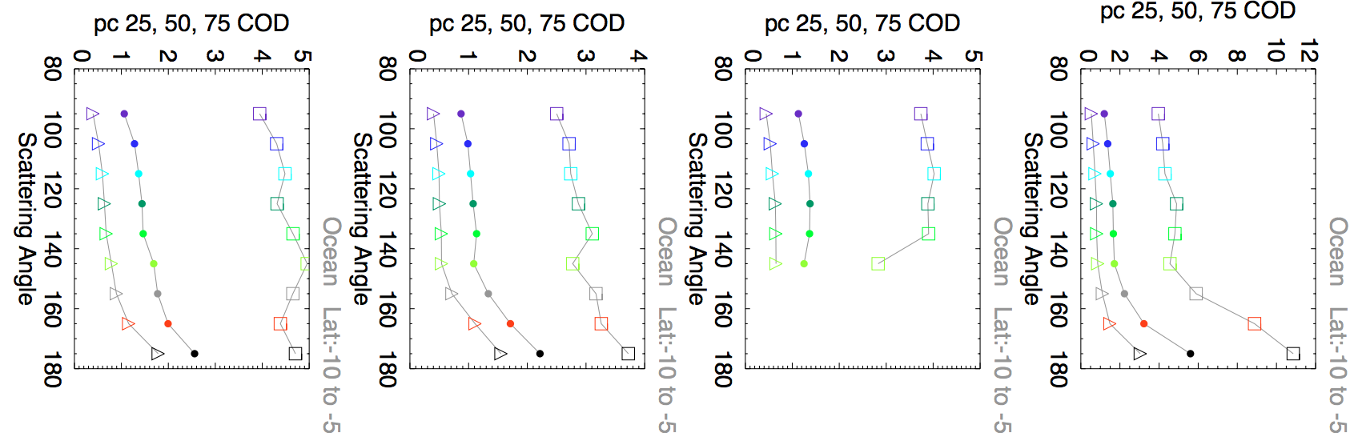
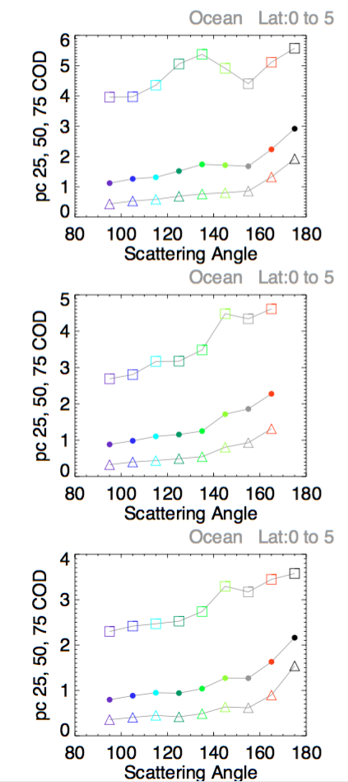
Ocean Lat: 0º to 5º N
Climatological COD 0.0-3.0
Ocean Lat: 10º to 5º S
Climatological COD 0.0-3.0
Feb March April
Feb March April
75th
50th
25th
Glint
May June July
Aug Sept Oct
Aug Sept Oct
Nov Dec Jan
Notes:
Showing percentile binned by Scattering Angle instead of diurnal cycle using the EPIC data.
As we move closer to glint conditions the COD increases by 1 COD unit.

Slide 16
No Conclusions, but …
Correcting diurnal sampling and scanning sampling biases is critical to generating a consistent cloud dataset.
DSCOVR has provides invaluable observations towards this correction.

Slide 17
Backup Slides

Slide 18
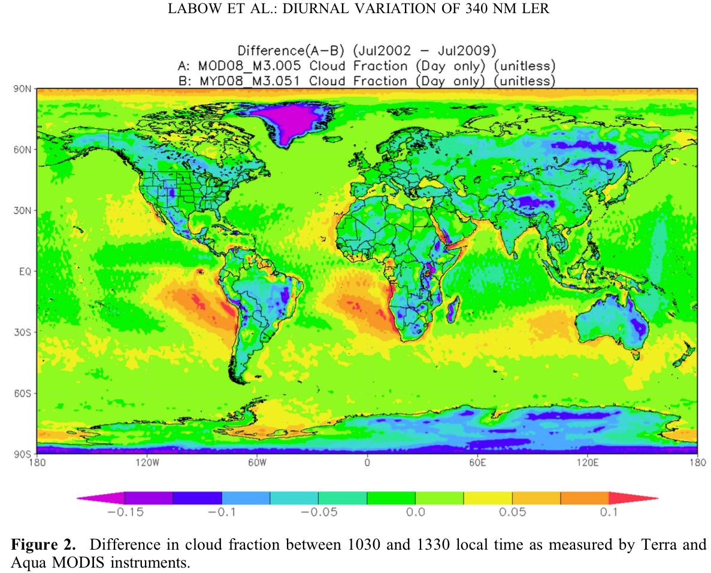

Slide 19
Antarctic Calibrated SBUV Intensities
(from N-values
331 & 340nm )
Lambertian Equivalent Reflectivity
Cloud Optical Depth
Adjustment to Noon-time
Cloud Optical Depth
EPIC
EPIC
Cloud Optical Depth
Adustment to
155º Scattering Angle
Notes:
That was from Nimbus 7, Here is a time-line of all the other SBUV instruments we will use in this study.

Slide 20
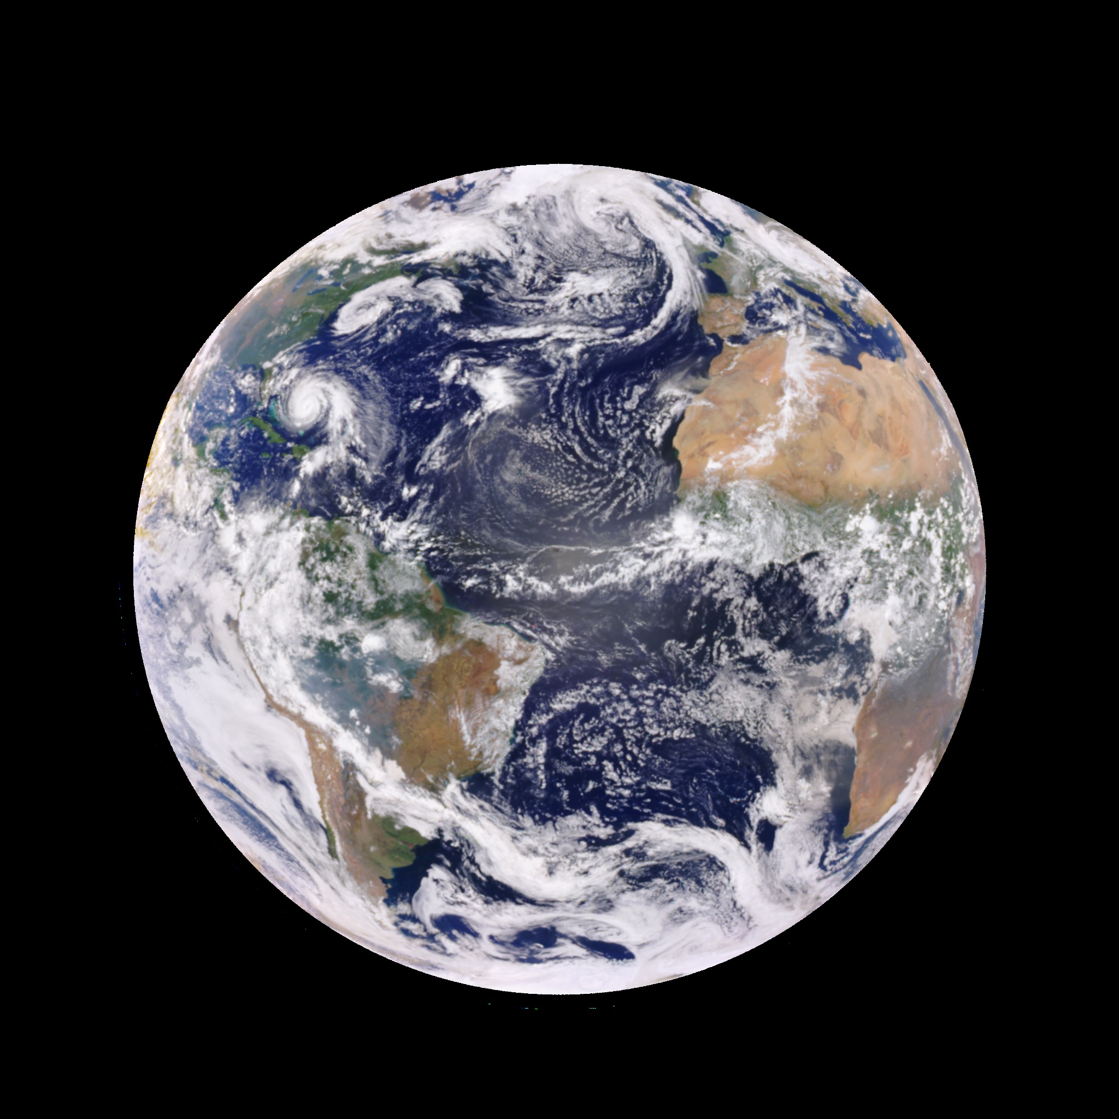
Sept 23, 2017
Early Morning
epic_RGB_20170923133137

Slide 21
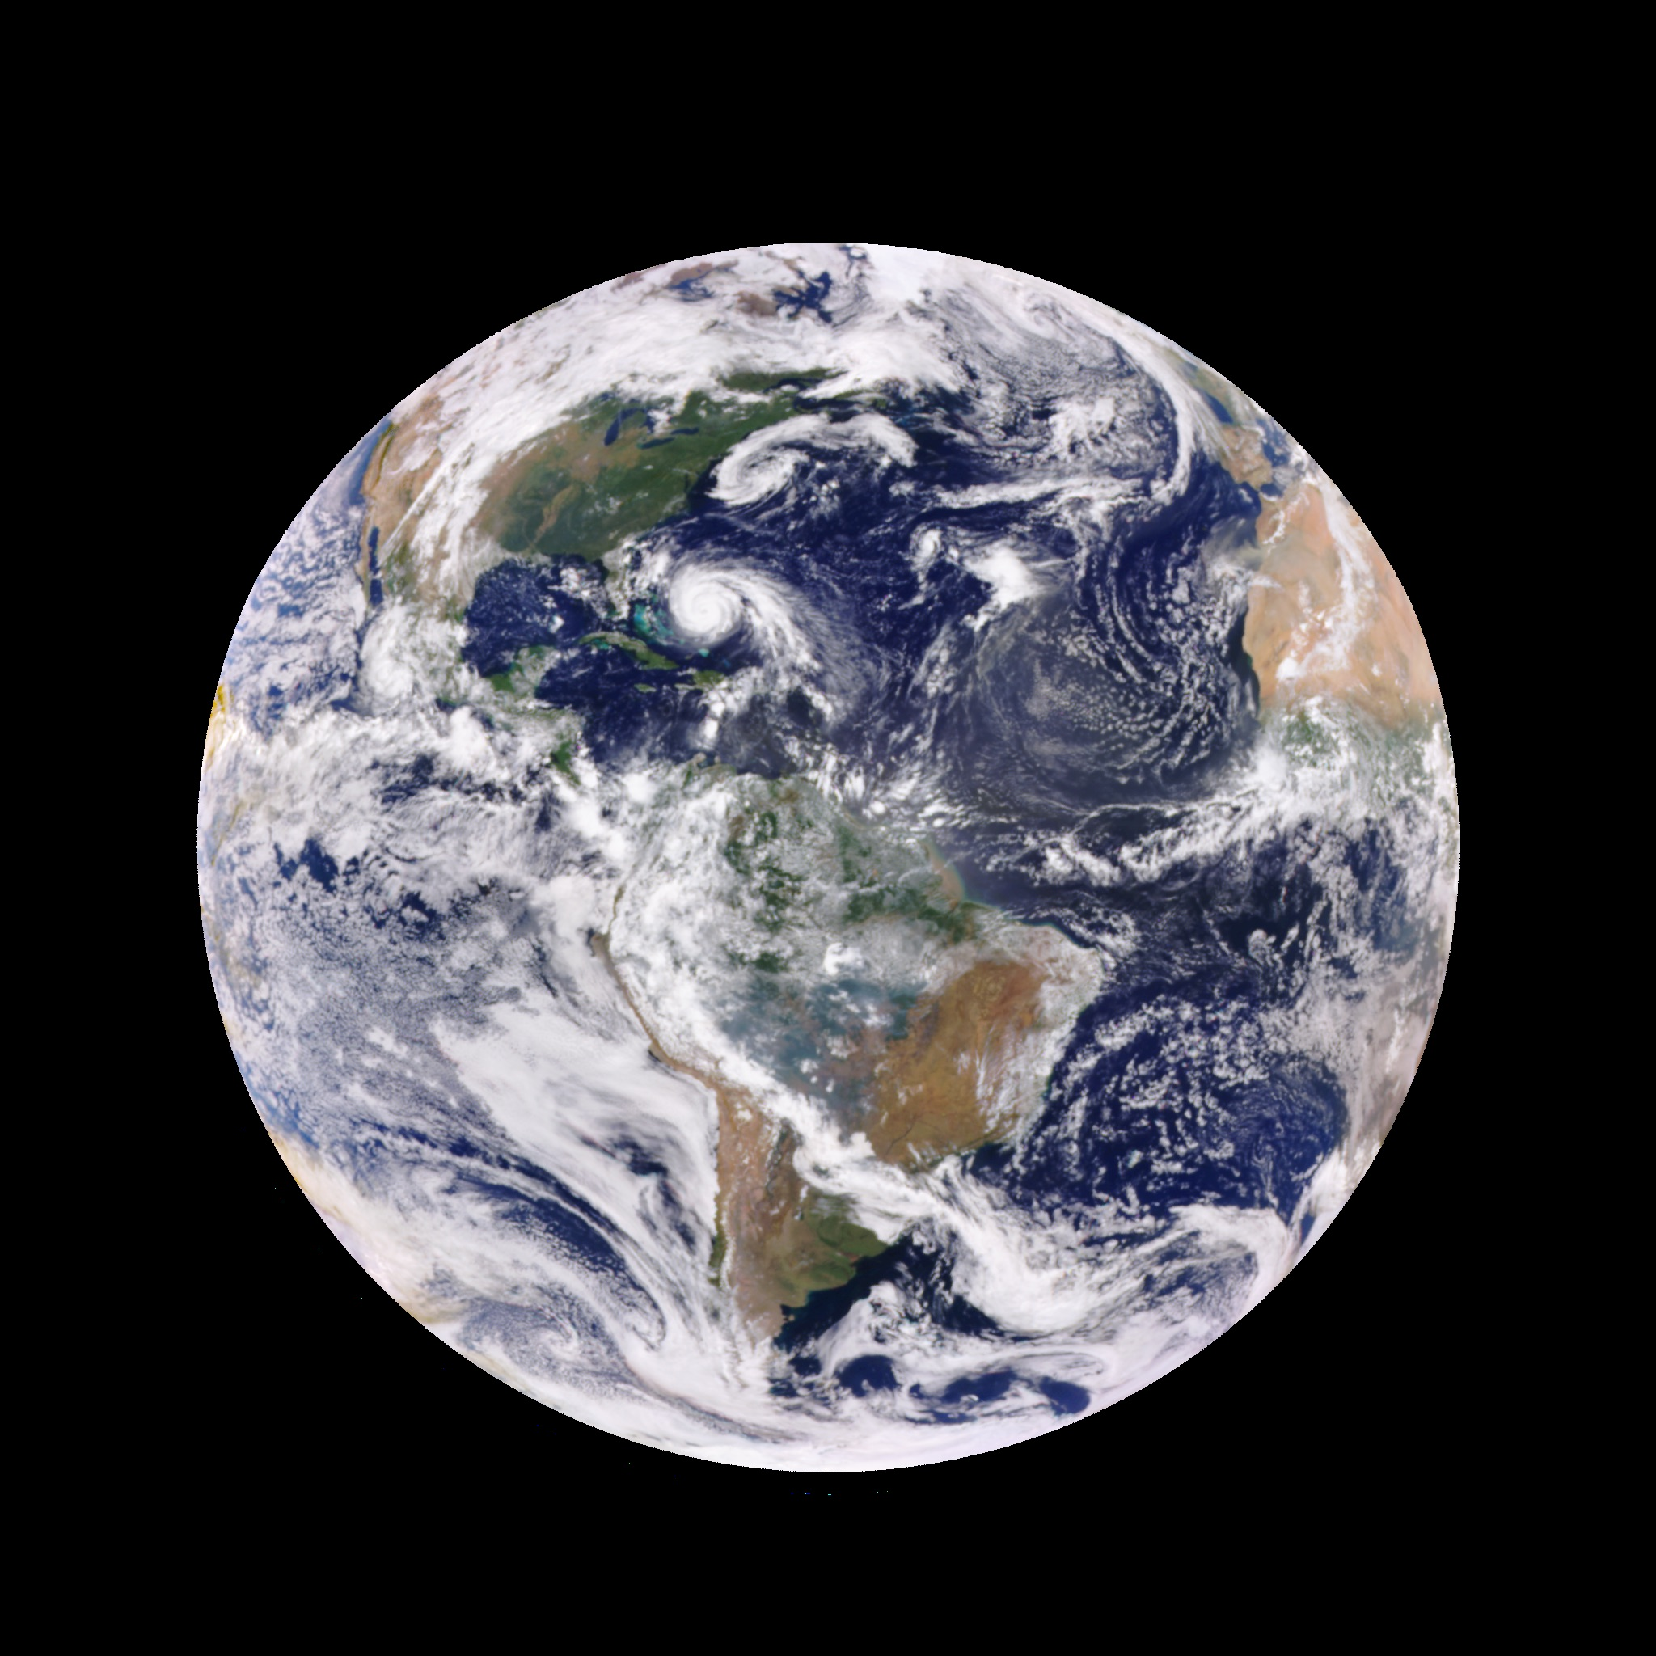
Sept 23, 2017
Late morning

Slide 22
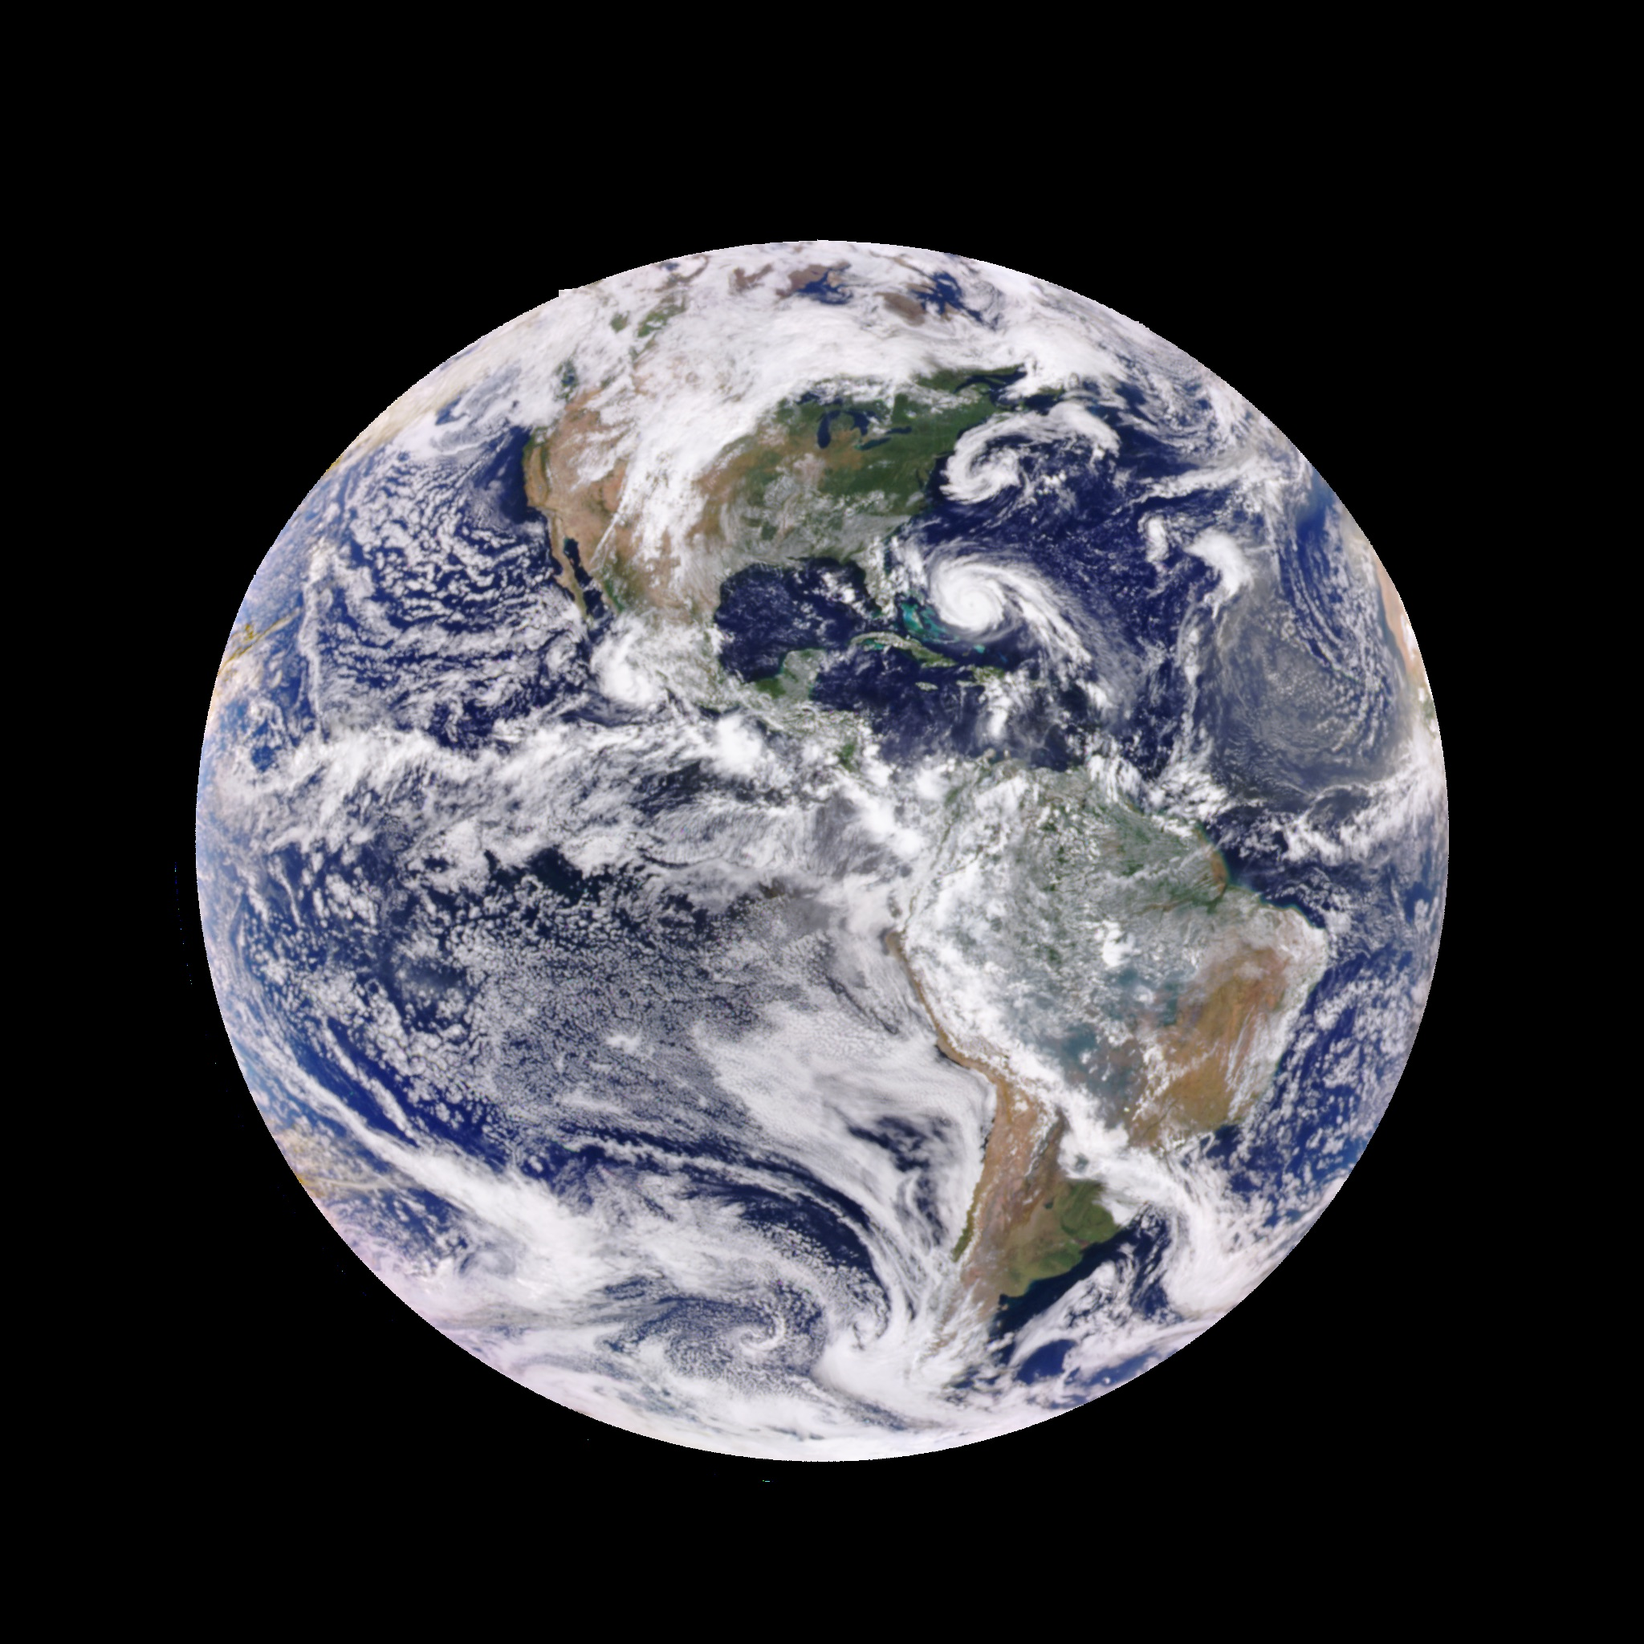
Sept 23, 2017
Early Afternoon
epic_RGB_20170923170743

Slide 23
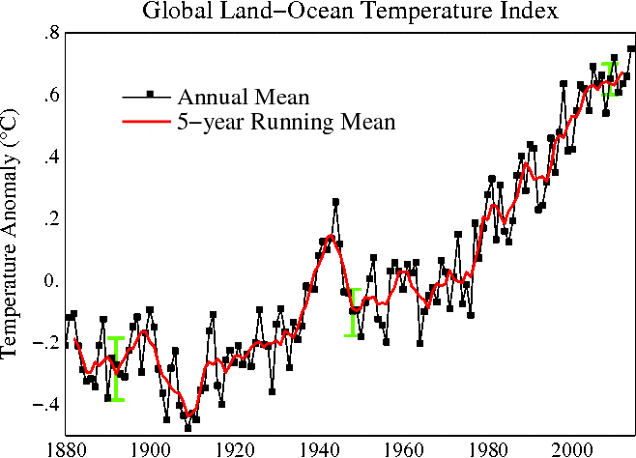
CERES
Nimbus-7
Nimbus-4
Notes:
Here is a 1987 paper written by our own Tom Eck and PK …

Slide 24
UV - 340 nm
Upwelling radiances
Rayleigh
Scattering
Cloud: 90 RU
SNOW & ICE
LAND
Reflectance = 2-4 RU
OCEAN
Reflectance = 5-8 RU
Notes:
Compenents of UV-340 nm upwelling radiation
Clouds
Snow and Ice
Rayleigh
Land and Ocean – low albedo

Slide 25
UV - 340 nm
Lambertian Equivalent Reflectance
Cloud: 90 RU
LER Removes Rayleigh Scattering
LAND
Reflectance = 2-4 RU
OCEAN
Reflectance = 5-8 RU
Notes:
The UV quantity we actually start off with is the UV Lambertian Equivalent Reflectance – UVLER.
From now on 340 nm
Remove Rayleigh and assume a lambertian surface .

