Slide 1
NIST Advanced Radiometer
NISTAR Update
Dr. Steven Lorentz
Dr. Yinan Yu
L-1 Standards and Technology

Slide 2
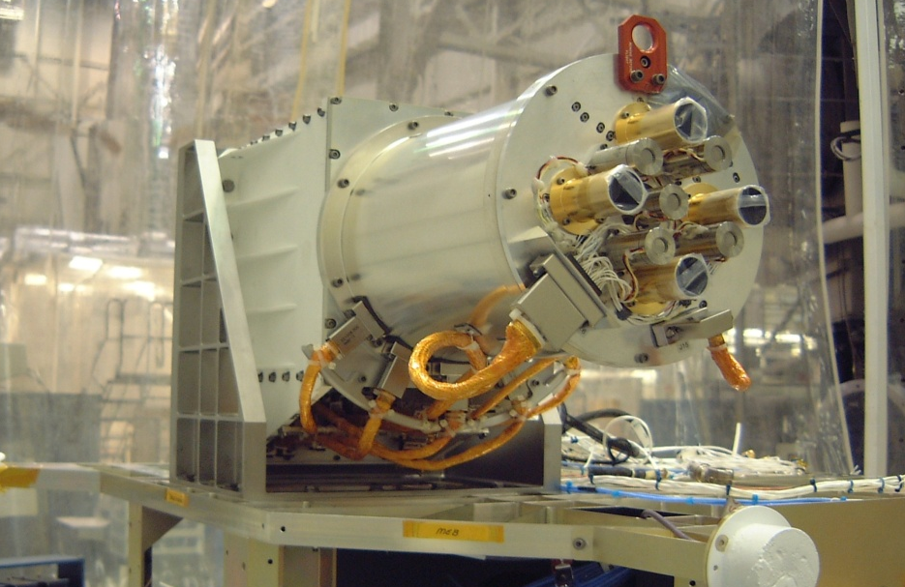
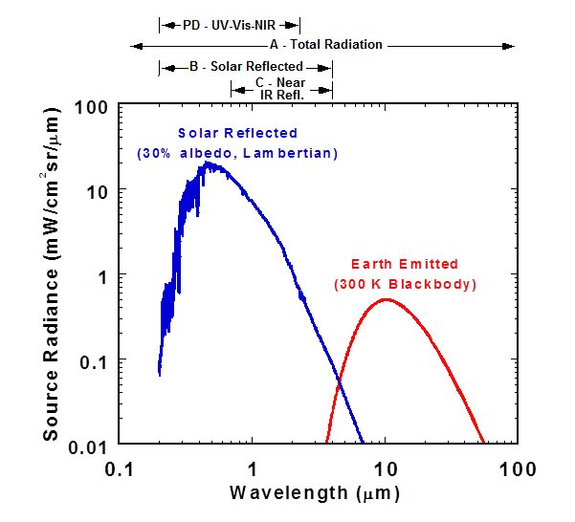
NISTAR
NIST Advanced Radiometer
NISTAR measures the solar reflected and Earth emitted irradiance along the Earth-Sun line
in 4 broadband channels.
Channel | Wavelengths | Description
Photodiode | 0.2 to 1.1 μm | UV-Vis-NIR
Band A | 0.2 to 100 μm | Total Radiation
Band B | 0.2 to 4 μm | Total Solar Reflected
Band C | 0.7 to 4μm | Near IR Solar Reflected
NISTAR Science Requirements:
NISTAR will provide measurements that could be used to determine the Earth reflected irradiance in the wavelength range of 0.2-100 microns with an accuracy of 1.5% or better.

Slide 3
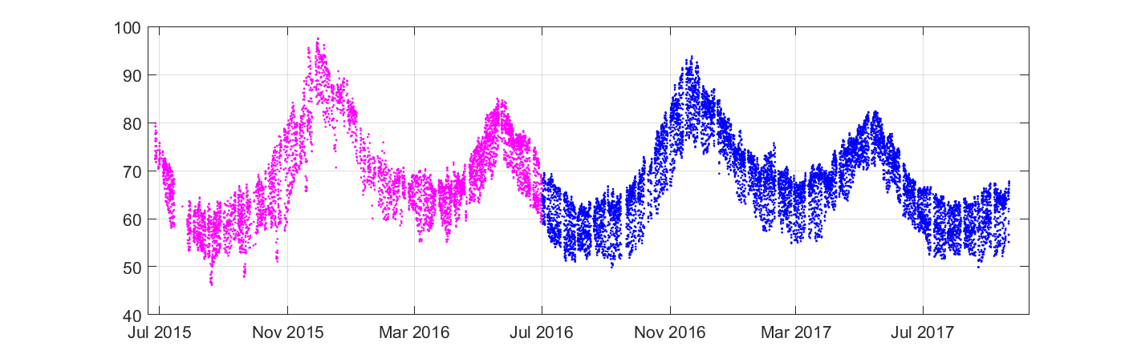
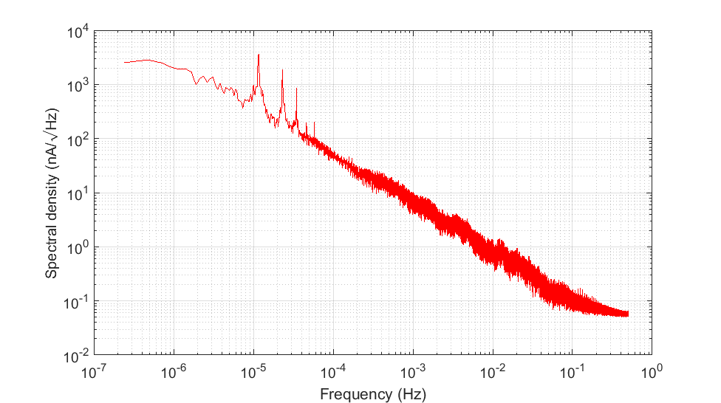
2 Year Data of Earth Photodiode Current
Mean = 68.8 nA
STD = 9.0 nA
Mean = 67.3 nA
STD = 8.7 nA
Very repeatable shape compared to last year
SNR > 6000 compared to the noise of dark space current offset (< 0.01 nA)
Daily variation 15 – 20 nA (~ 25% of average)
Spectrum yields a 1/f slope
1/f slope

Slide 4
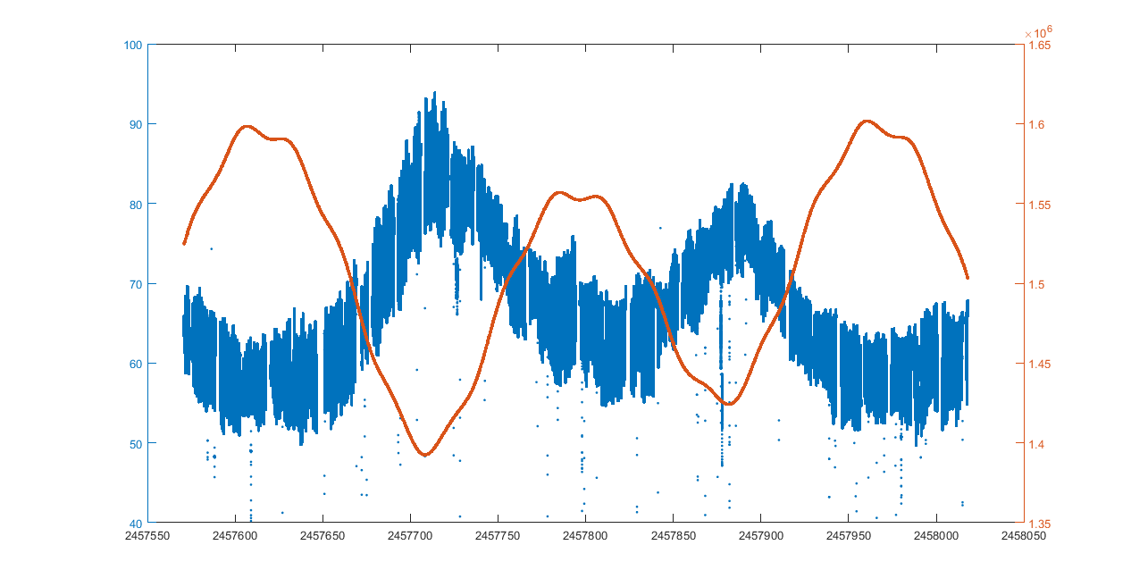
Earth PD Current vs. Earth Distance
PD Current (nA)
Earth Distance (km)
Julian Day
Shows clear anti-correlation between the PD current and earth distance

Slide 5
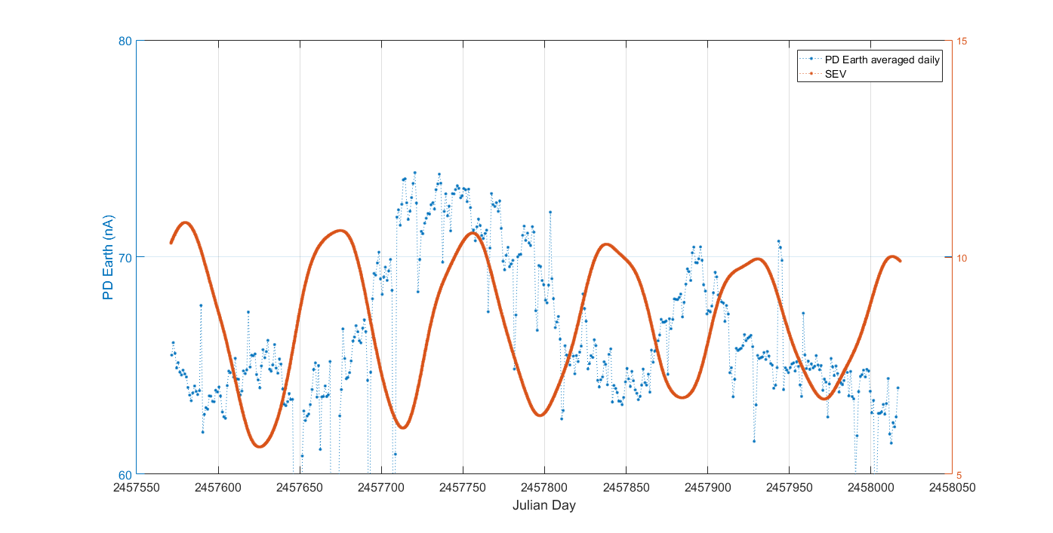
Earth PD Current vs. SEV Angle
Normalized to the averaged distance to remove the dependency on the Earth distance
Less SEV angle corresponds to higher PD current

Slide 6
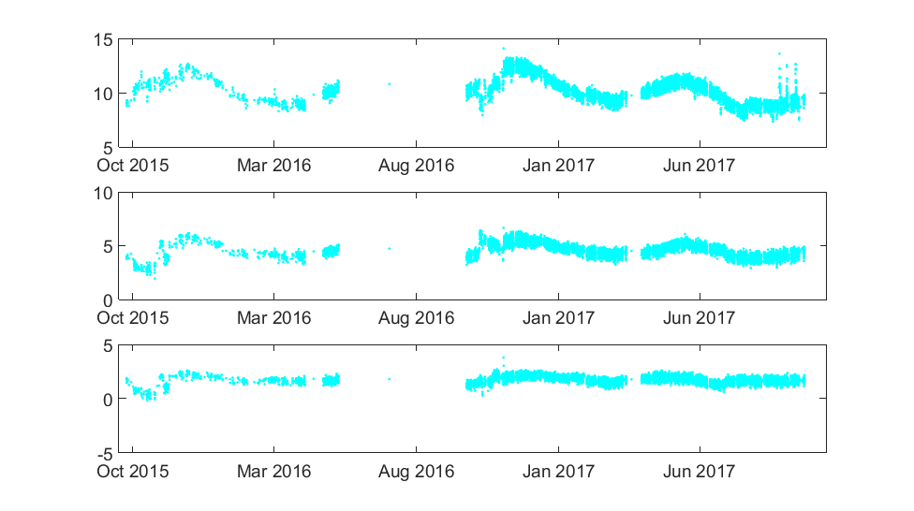
2 Year Data of Earth Irradiance
Mean = 10.2
STD = 1.25
Mean = 4.61
STD = 0.748
Mean = 1.76
STD = 0.511

Slide 7
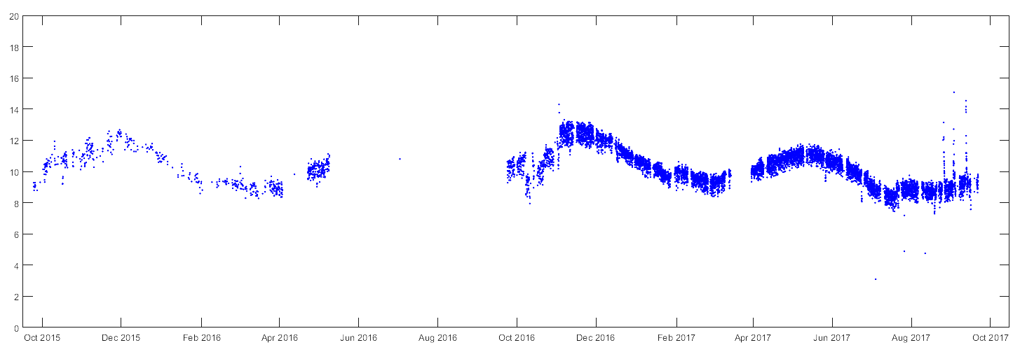
9/23/2016 changed to 4 minute autocycle
4/18/2016 RC1 Railed
11/2/2016 PID parameter adjustment
3/6/2017 - 3/30/2017 RC2 Railed
6/10/2016 – 7/18/2016 RC bad temperature control
8/8/2016 – 8/31/2016 RC bad temperature control
7/4/2017 RC2 Shutter BIT failure
7/7/2017 RC3 Shutter BIT failure
Frequent RC shutter BIT failure since July
Had no significant effect on the Earth and on-orbit calibration data
Problem alleviated by power cycle performed in August
7/18/2017 RC3 Shutter BIT failure
7/27/2017 RC2 Shutter BIT failure
7/31/2017 RC1 Shutter BIT failure
8/10/2017 RC2 Shutter BIT failure
9/15/2017 RC2 Shutter BIT failure

Slide 8
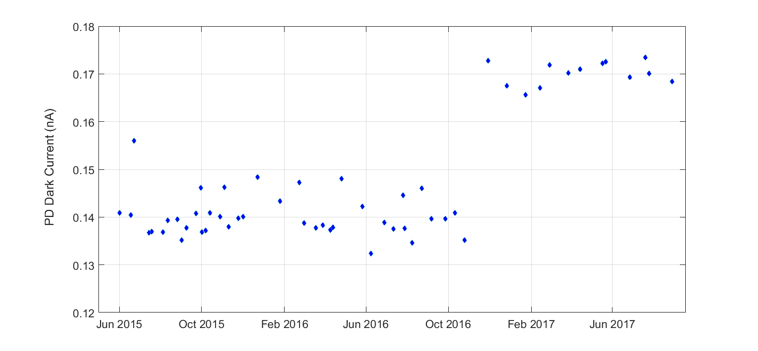
Dark Space Offset – PD Current
0.03 nA
Consistent before and after November 2016
Increased by 30 pA after November 2016
Affected by the PID parameter adjustment on 11/02/2016?

Slide 9
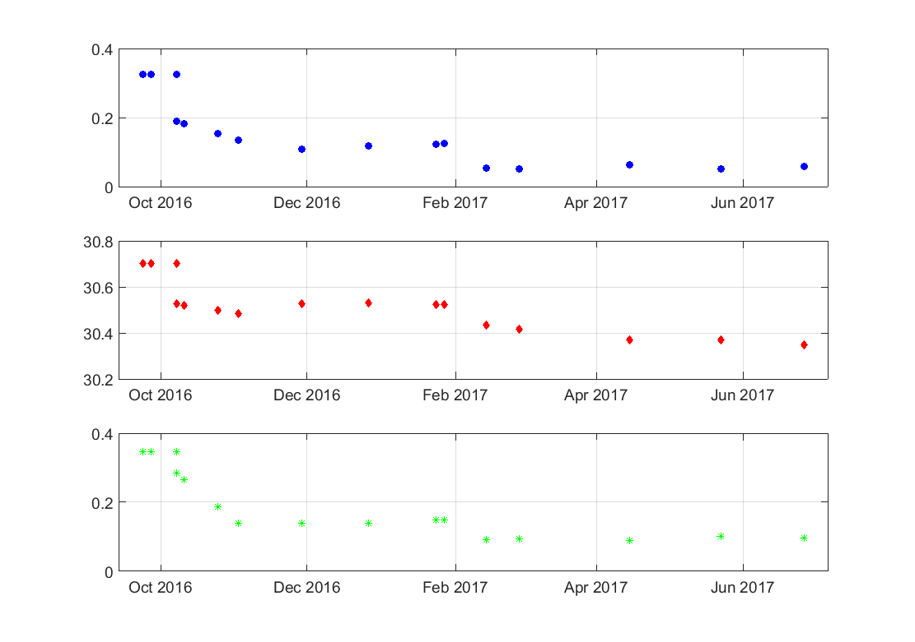
Dark Space Offset – Radiometer Power
RC1
RC2
RC3
Autocycle = 4 minutes, FW position = 3

Slide 10
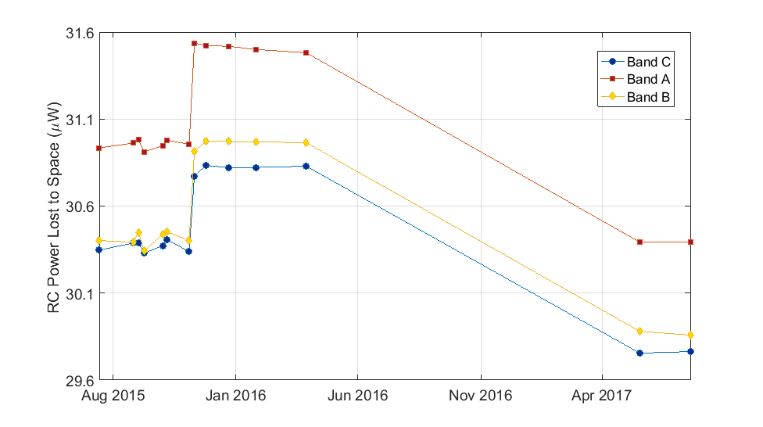

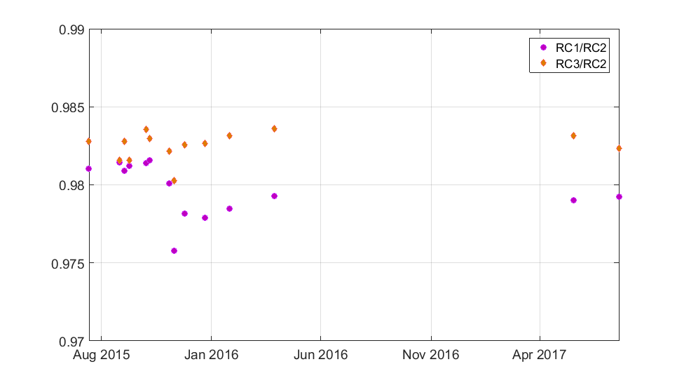
Short Receiver Intercomparison
FW position = 102
8 hour Earth observation to compare the relative responsivities between the radiometers
Plot shows total flux dark power
autocycle
10 min
30 min
4 min
Earth Irradiance Ratios

Slide 11
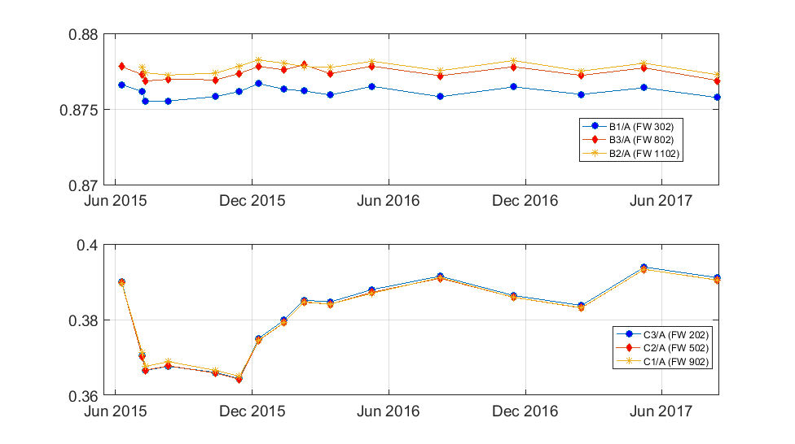
Rapid Filter Intercomparison

