Slide 1
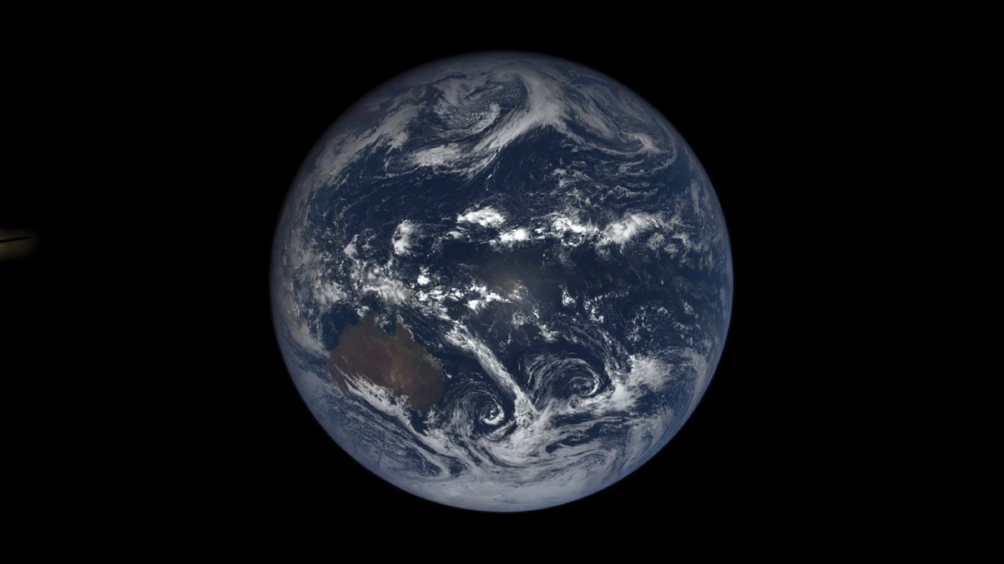
EPIC sequence: 31 Oct 2016, 0342 – 1240 UTC

