Slide 1
Validation of EPIC V02 Ozone Amounts Using OMI and OMPS
Jay Herman and Liang Huang
Comparisons at specified sites
Boulder, Colorado
Washington, DC
Waterflow, NM
Seoul and Busan, Korea
Thessaloniki, Greece
Mauna Loa, Hawaii
Buenos Aires, Argentina
Johannesburg, South africa
Sydney Australia
NH
----------------------------------------------------------------------------
SH
The validation will be redone with V03 ozone when available in 2 months

Slide 2
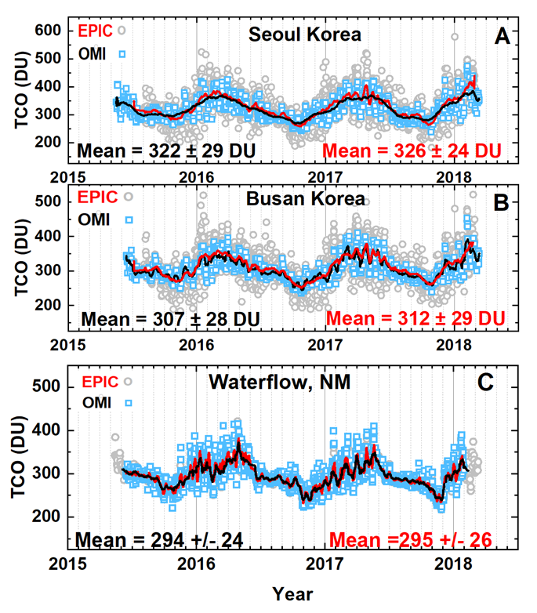
Comparison of EPIC Total Column Ozone (TCO) with OMI TCO
Solid lines = 10 day Average
Grey = All EPIC data
Blue = All OMI Data
Location | EPIC Mean | OMI Mean | Pct Diff
Seoul | 326 | 322 | 1.2
Busan | 312 | 307 | 1.6
Waterflow | 295 | 294 | 0.3
Units: DU = 2.69 x 10¹⁶ molecules/cm²

Slide 3
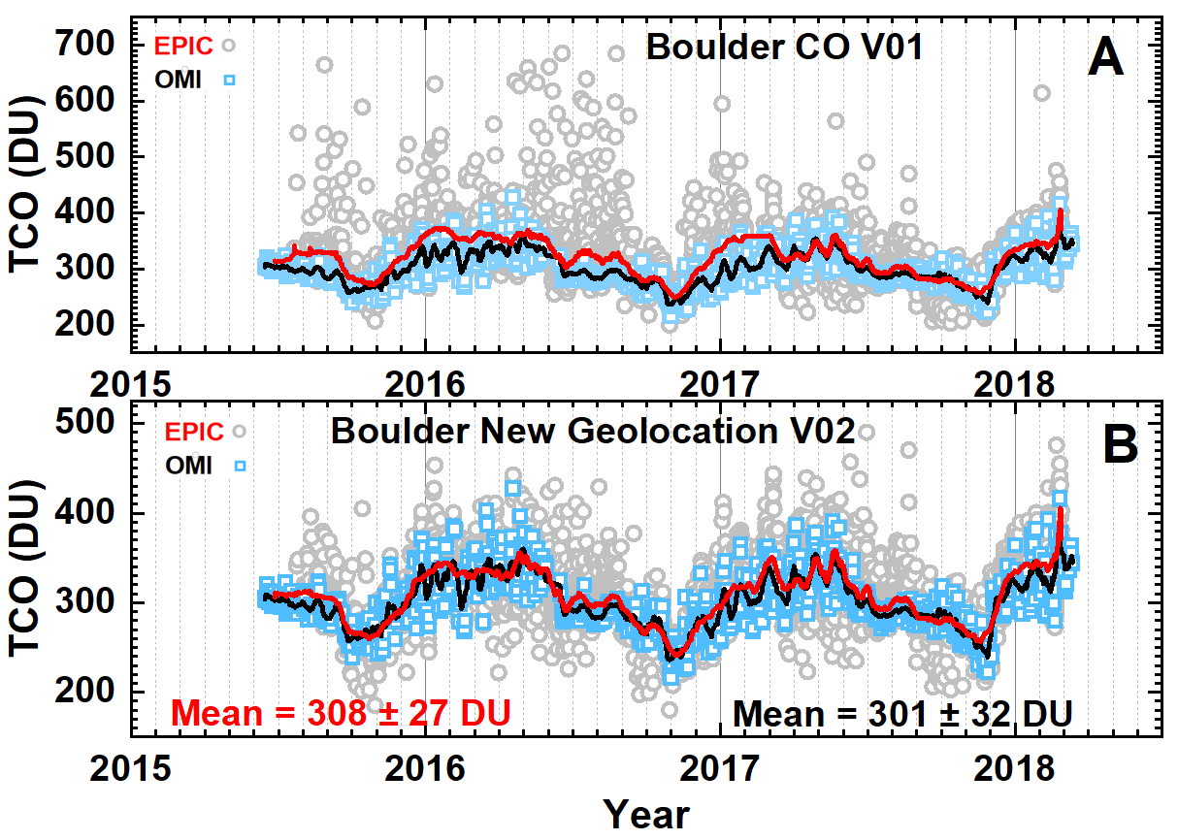
Comparison of O3 derived from V01 with V02 over Boulder Colorado

Slide 4
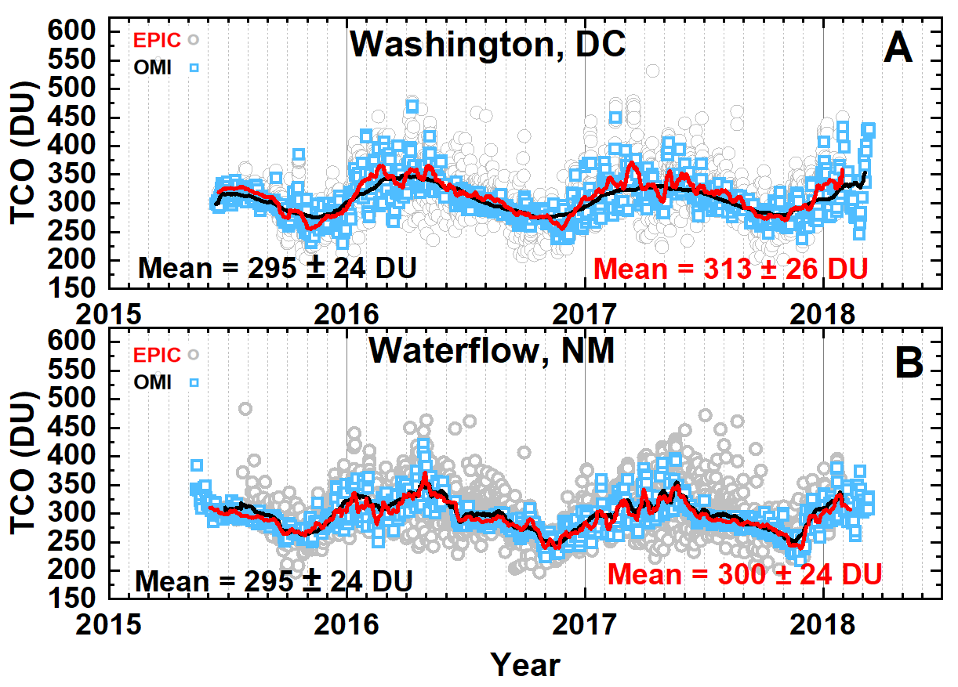
EPIC vs OMI over Washington DC

Slide 5
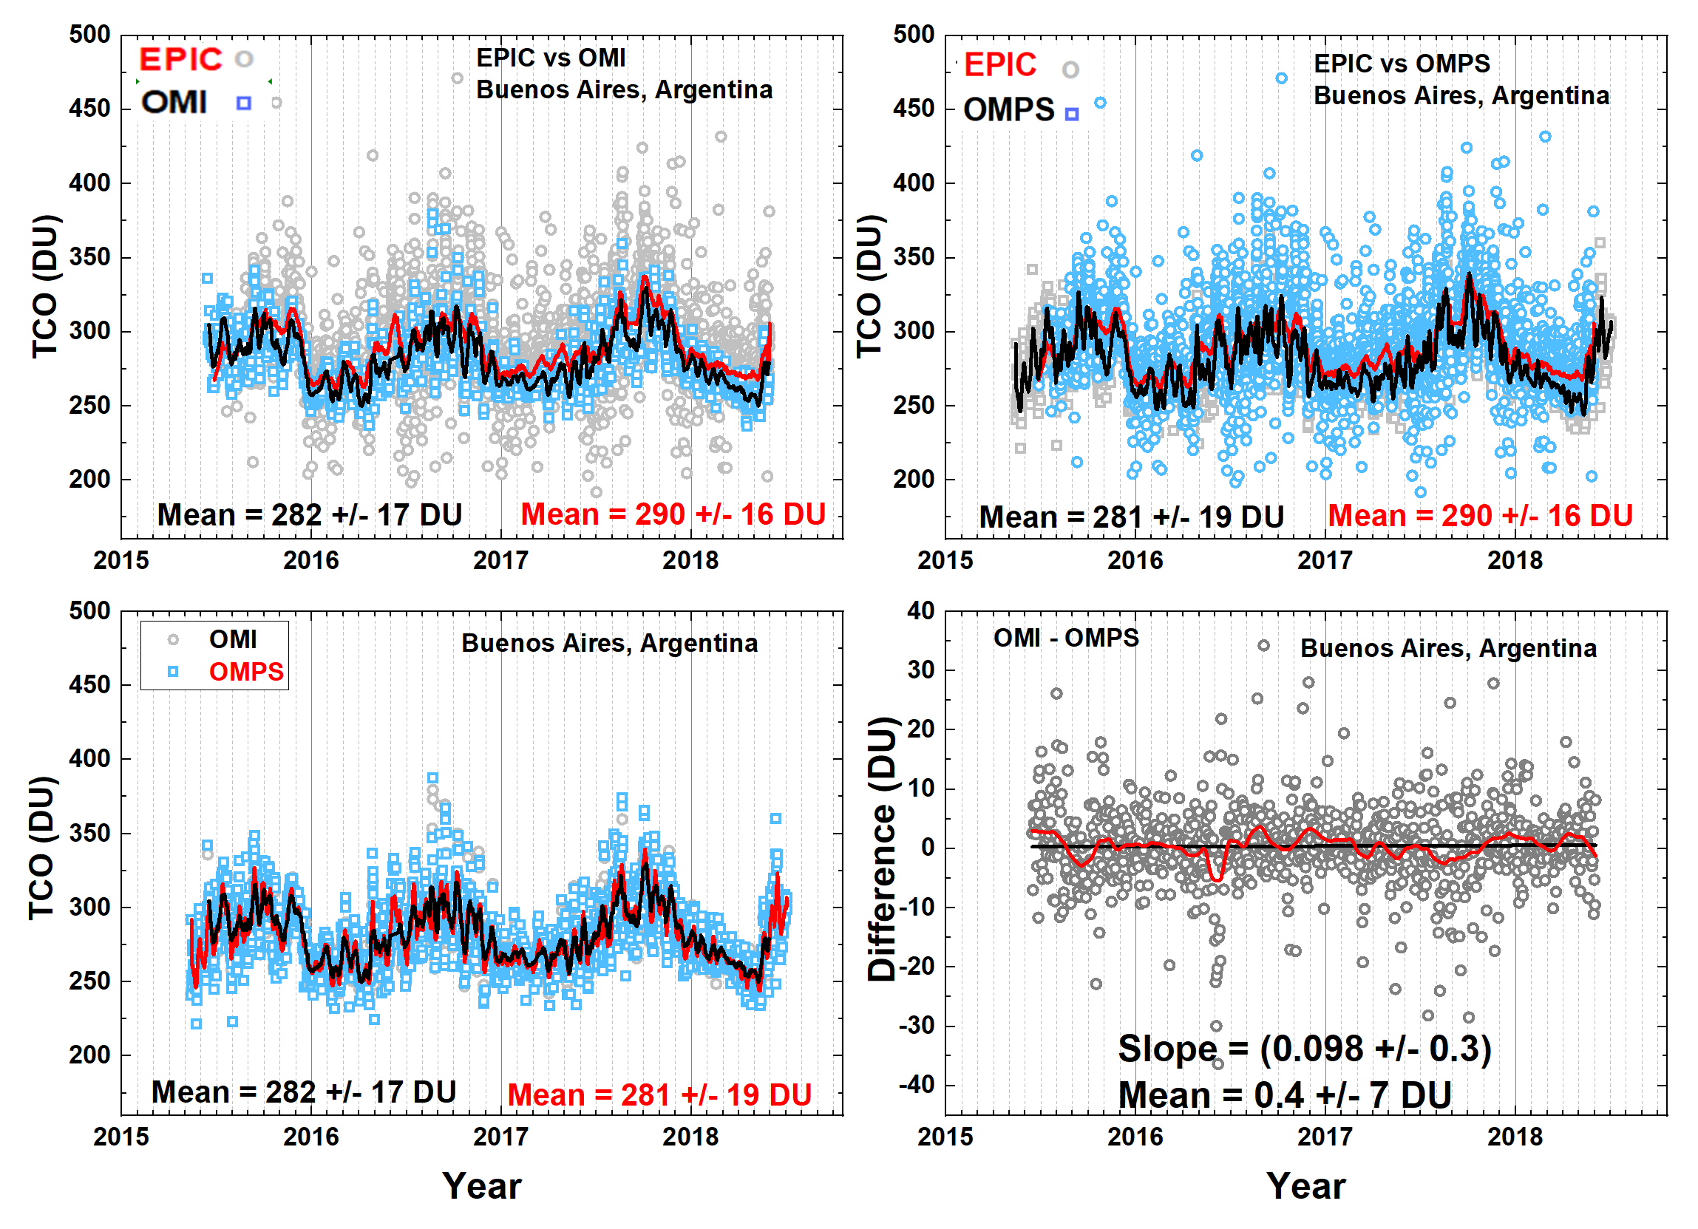
SH Buenos Aires, Argentina 34.58^{O}S, 58.48^{O}W

Slide 6
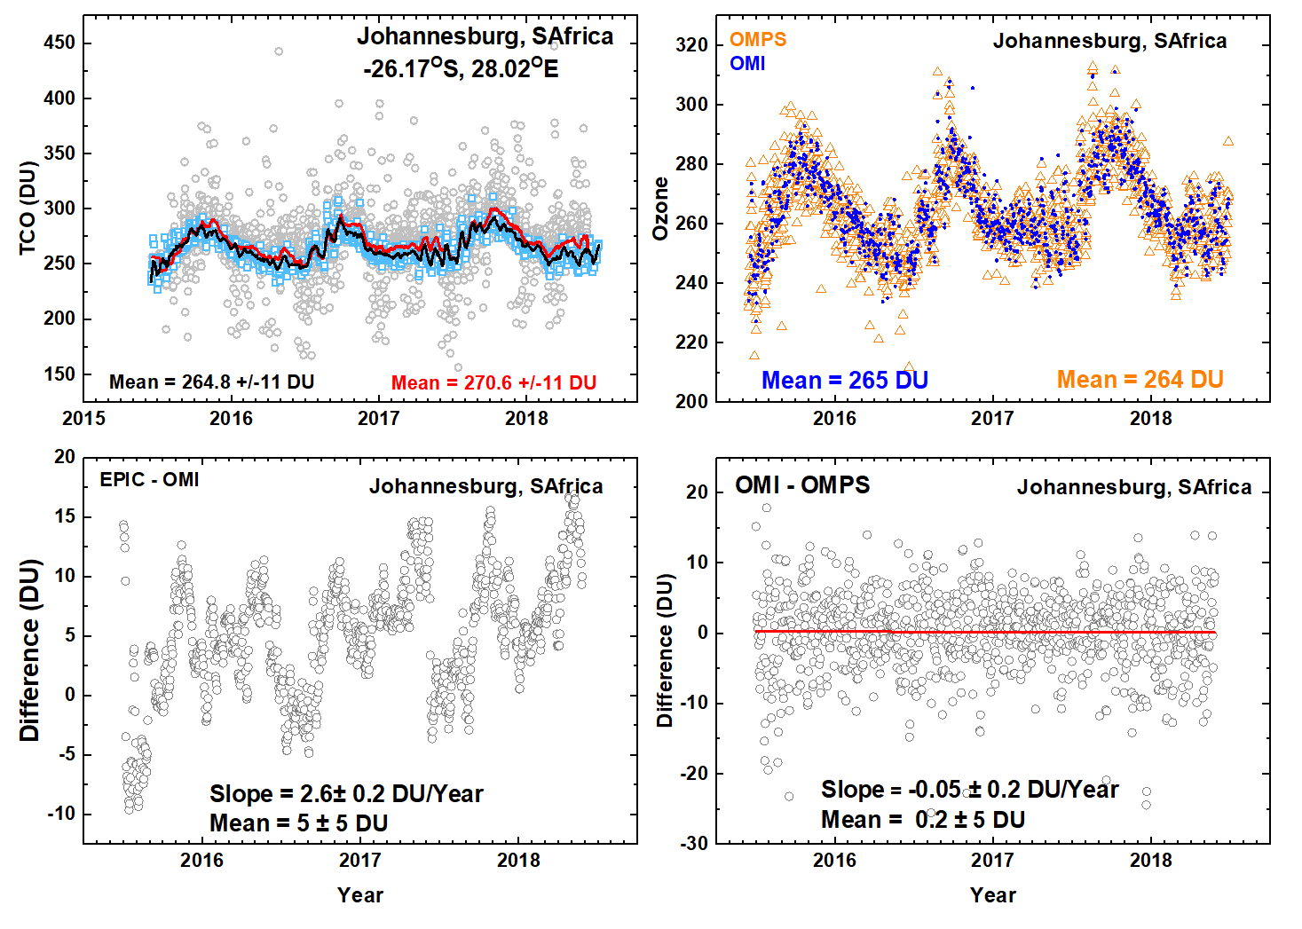
SH: Johannesburg, South Africa 26.17^{O}S, 28.02^{O}E

Slide 7
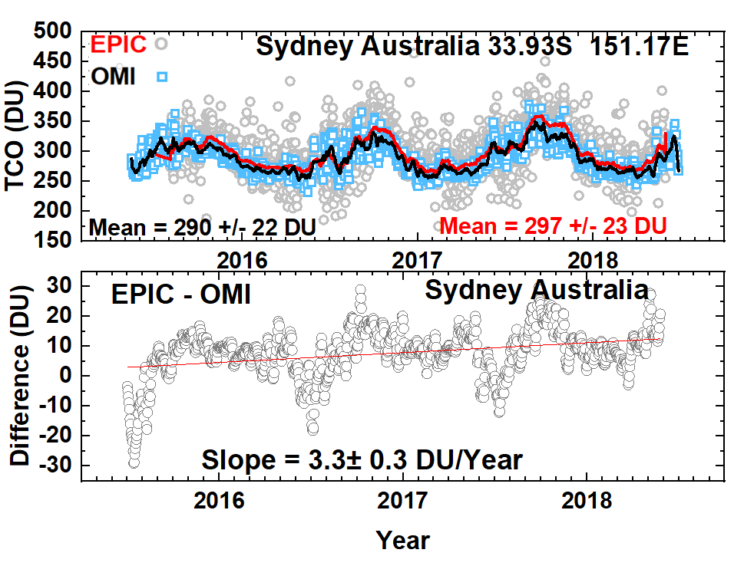
SH: Sydney Australia 33.93^{O}S 151.17^{O}E

Slide 8
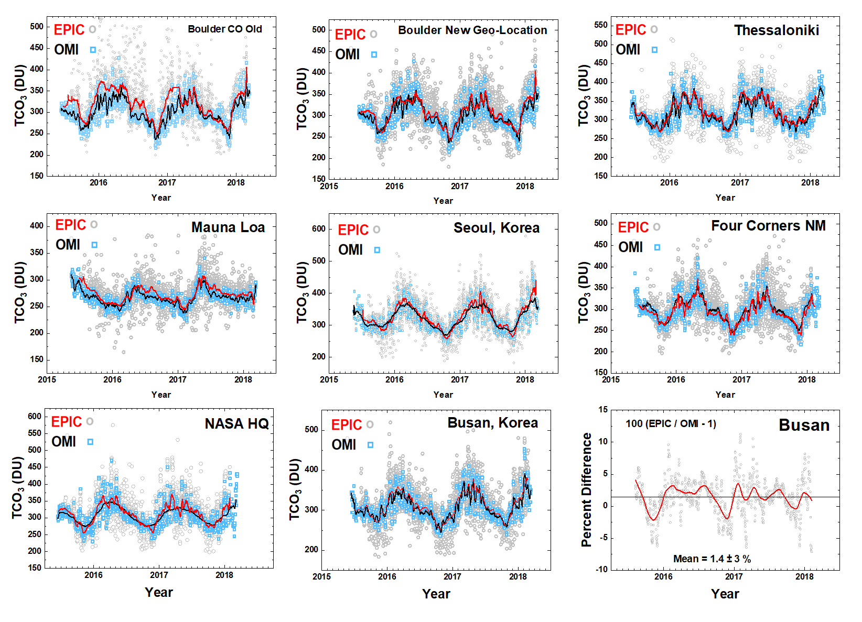
Summary: Good Agreement in NH, but not in SH
V01
V02

