Slide 1
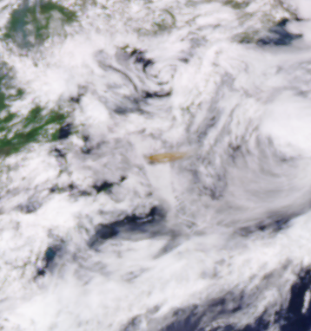
EPIC Level 2 Processing
DSCOVR Science Team Meeting
Goddard Space Flight Center (online)
Marshall Sutton/586
Marshall.H.Sutton@nasa.gov
September 28, 2021
EPIC Enhanced image Epic_RGB_2019062215123

Slide 2

My Role
Process Level 2 products using EPIC level 1 data
Collect ancillary products, including other Level 2 products
Deliver data products to ASDC
Automate process
Ad hoc processing
Helping science teams with NCCS

Slide 3
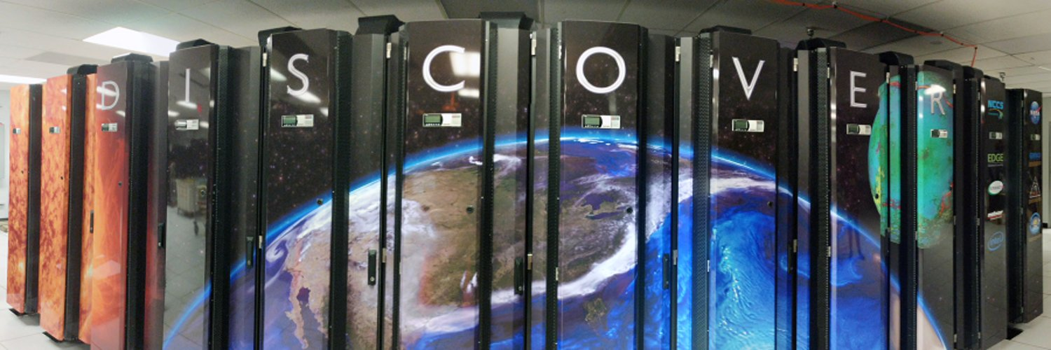
NCCS Help Desk
support@nccs.nasa.gov
https://nccs.nasa.gov
Libraries
Optimization
Parallel processing
General Help

Slide 4
Level 2+ products
Product | Start Date | End Date | Granules Available on ASDC | Granule Size (MB) | Dataset Size (TB) | Principal Investigator
EPIC 1b | 6/13/15 | 9/14/21 | 29,561 | 377 | 9.5 | A. Marshak
UV AEROSOL | 6/16/15 | 9/12/21 | 29,049 | 140 | 4.4 | O. Torres
UV AEROSOL Fast | 8/26/21 | 9/7/21 | 274 | 201 | 0.05 | C. Ahn
TO3 | 1/1/17 | 9/12/21 | 27,697 | 193 | 4.9 | N. Kramarova
SO2 | 1/2/16 | 4/15/21 | 1,179 | 215 | 0.26 | S. Carn
O3SO2AI | 6/13/15 | 9/6/21 | 28,618 | 65 | 1.8 | K. Yang
Cloud | 1/1/17 | 9/11/21 | 28,262 | 292 | 7.0 | Y. Yang
Atm. Correction | 6/13/15 | 9/30/20 | 22,191 | 75 | 2.2 | A. Lyapustin
Vegetation | 1/1/19 | 9/30/20 | 21,257 | 37 | 0.772 | Yuri
Glint | 6/16/15 | 8/31/21 | 19,617 | 875 | 23.8 | T. Varnai
Nistar-EPIC | - | - | - | - | - | C. Weaver
Ocean Product | 1/1/16 | 8/29/21 | 29,561 | 377 | 9.5 | R. Frouin
Tropospheric Ozone | - | - | - | - | - | J. Ziemke
Total |  |  |  |  | 54.7

Slide 5
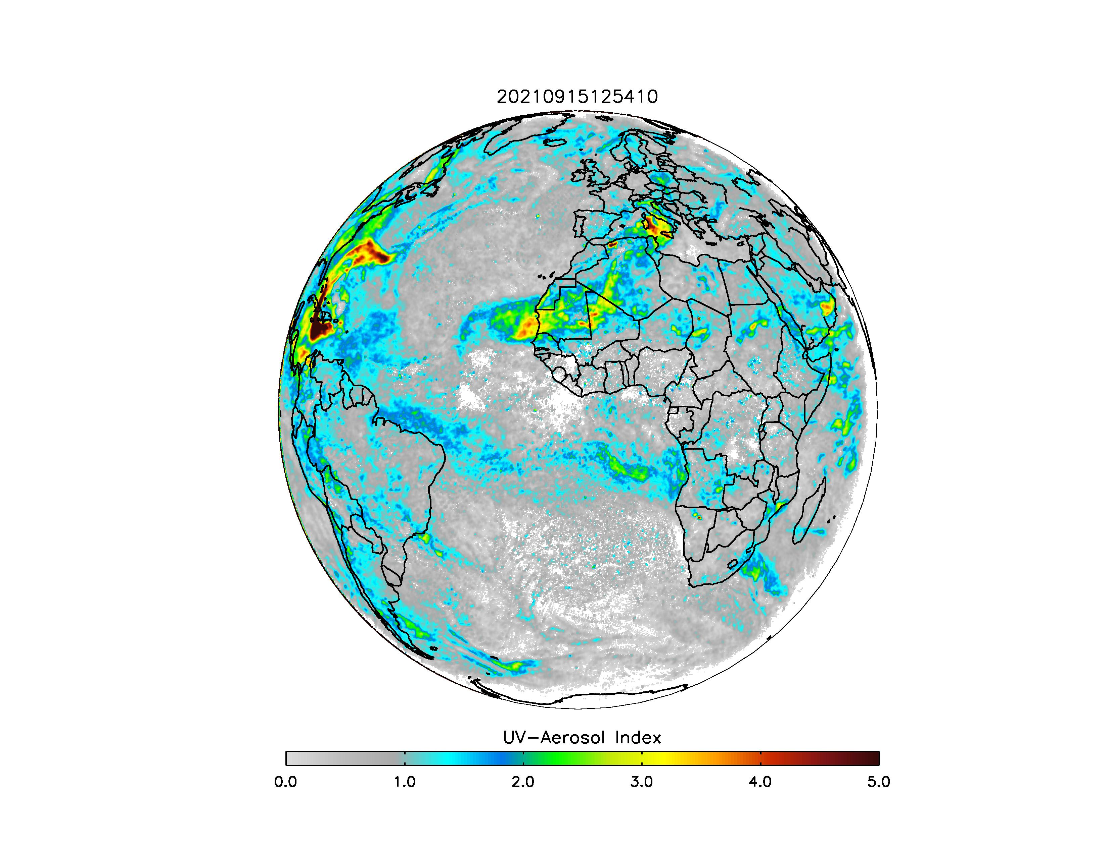
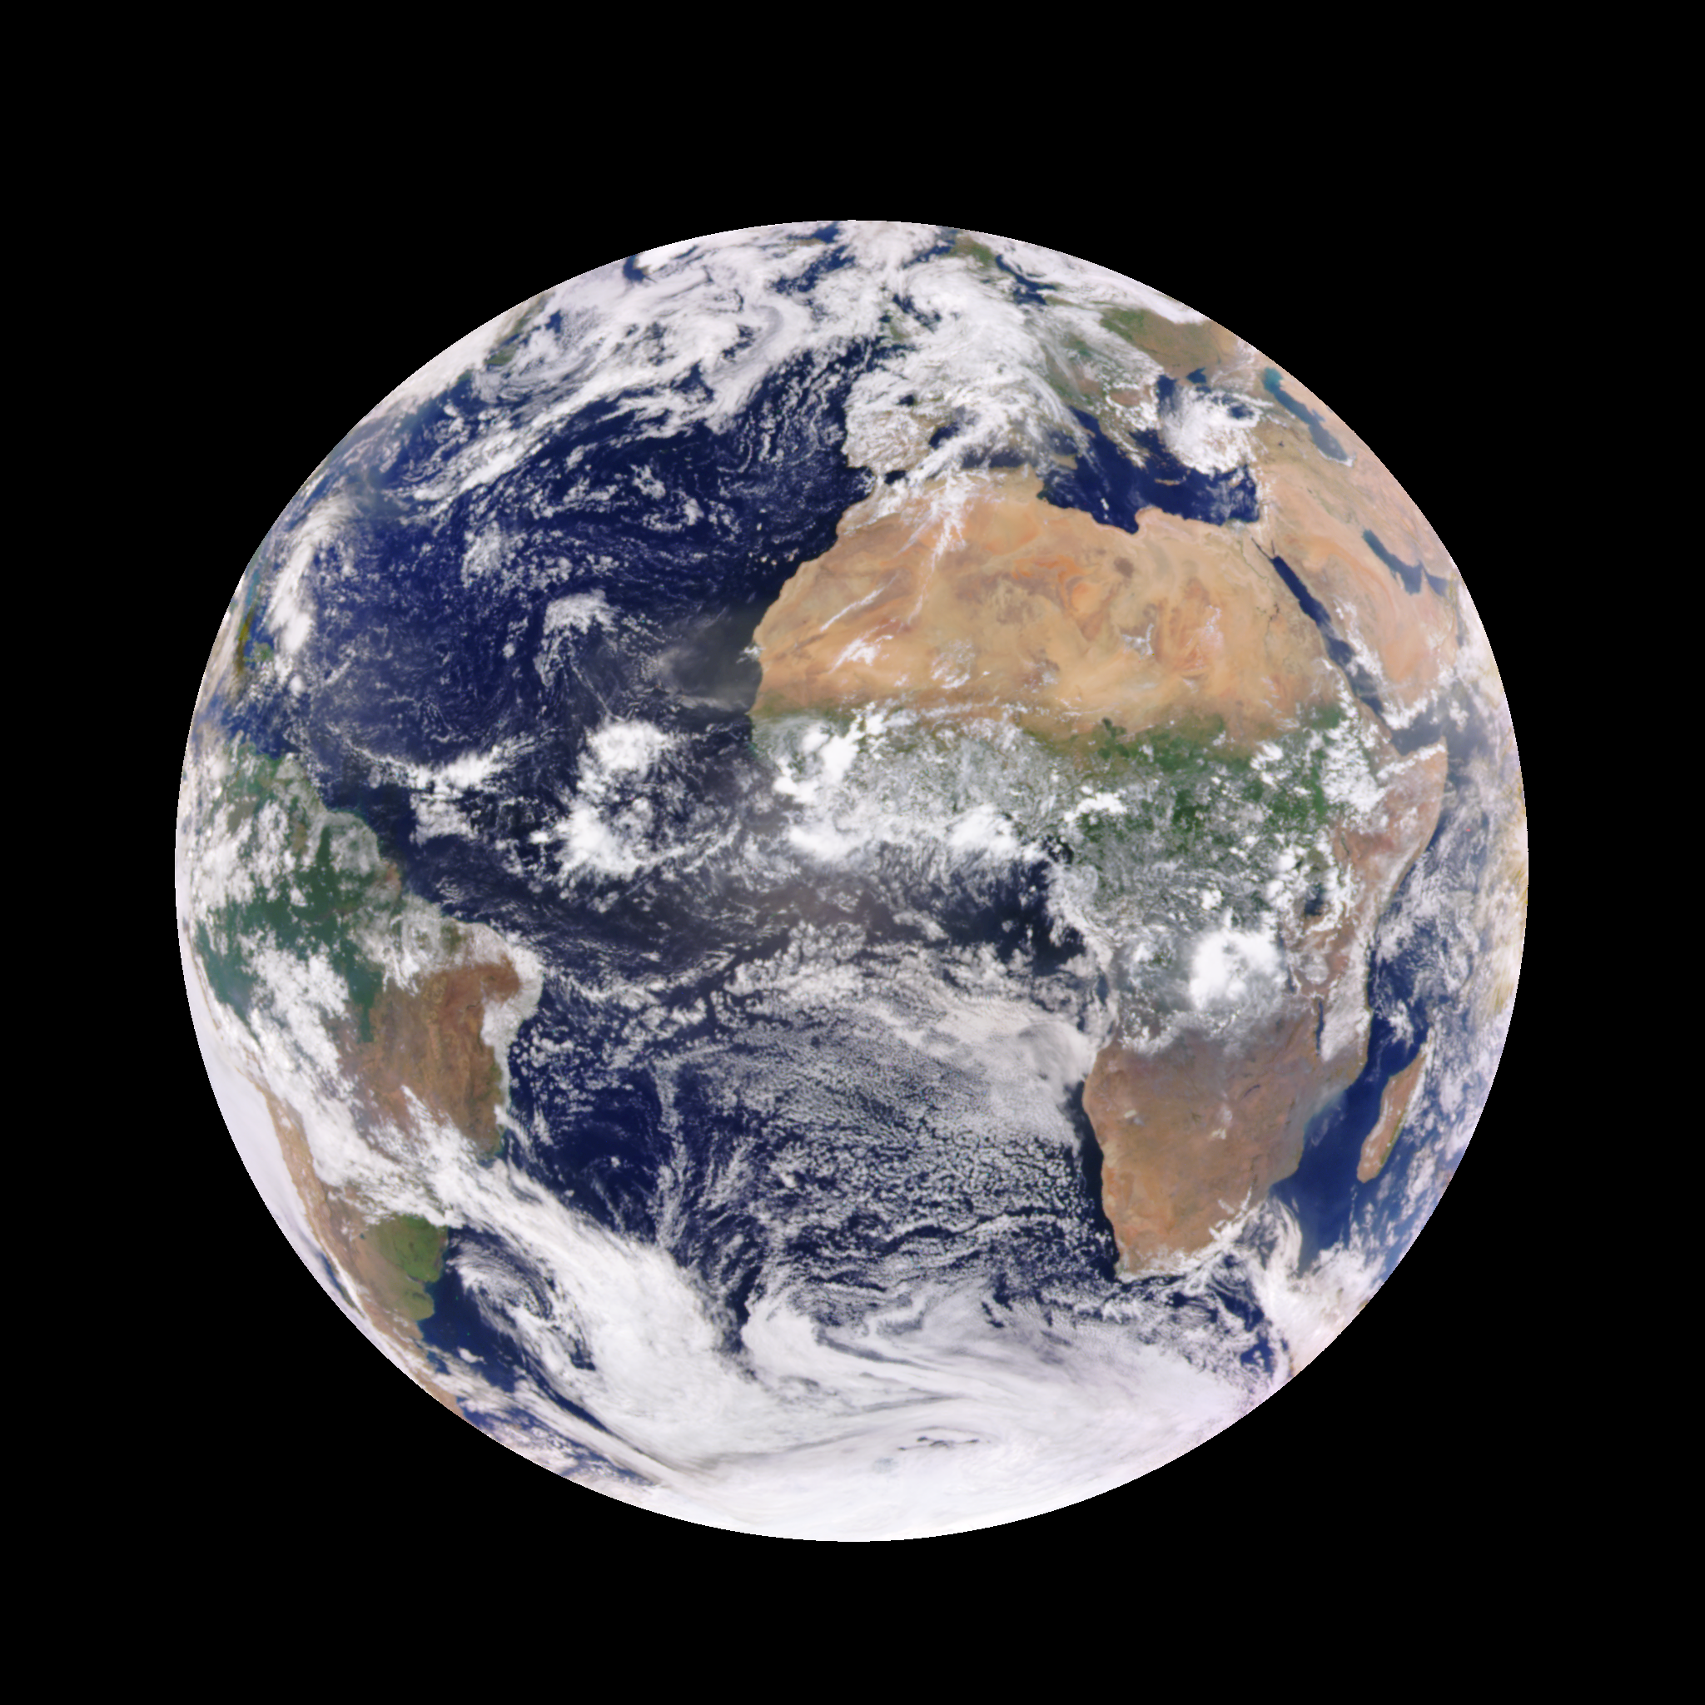
Plots Using Level 2 Data
AEROSOL UV:
uvai
EPIC_1b:
Enhanced images
Ocean Product:
Browse Image

Slide 6
How to get data
Earthdata Search (https://search.earthdata.nasa.gov/)
https://asdc.larc.nasa.gov/data/DSCOVR/EPIC/
#!/bin/bash
URL=https://asdc.larc.nasa.gov/data/DSCOVR/EPIC/L2_O3SO2AI_02/2021/07
USERNAME=*********** # Earthdata Login
PASSWORD=*********** # Earthdata password
touch .netrc
echo "machine urs.earthdata.nasa.gov login $USERNAME password $PASSWORD" > .netrc
chmod 0600 .netrc
touch .urs_cookies
wget --load-cookies ~/.urs_cookies --save-cookies ~/.urs_cookies --auth-no-challenge=on --keep-session-cookies --content-disposition --recursive --wait=60 --no-parent --reject "index.html*" --execute robots=off $URL

Slide 7
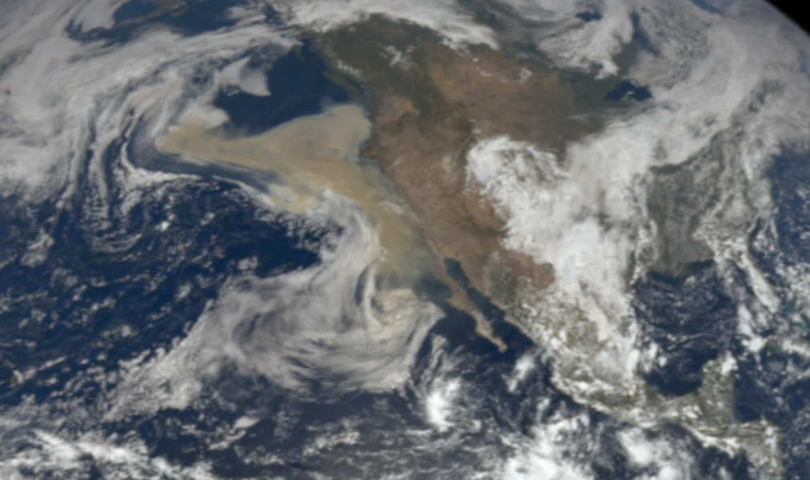
Special events
Volcanos
Wildfires
Dust storms
Files can take a day or more to appear on ASDC
Reprocessing
epic_1b_20200910195701
1-2 months for entire dataset

